Slide 1
The Evidence for Current Cardiovascular Disease Prevention Guidelines:
Diabetes Mellitus Evidence and Guidelines
American College of Cardiology
Best Practice Quality Initiative Subcommittee
and Prevention Committee
Notes:
1
1

Slide 2
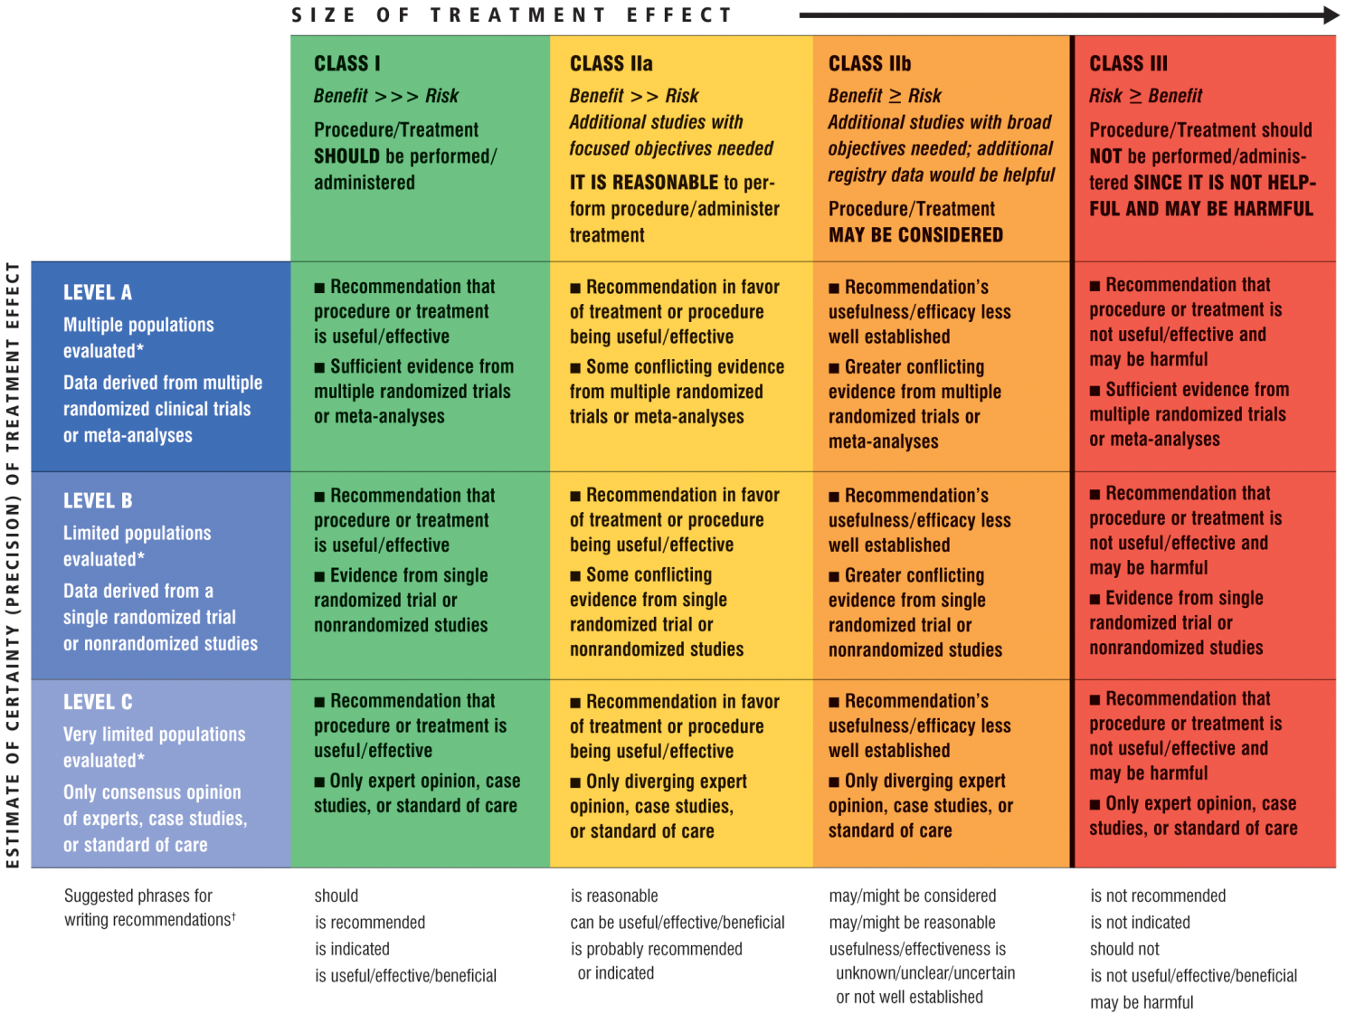
Classification of Recommendations and Levels of Evidence
*Data available from clinical trials or registries about the usefulness/efficacy in different subpopulations, such as gender, age, history of diabetes, history of prior myocardial infarction, history of heart failure, and prior aspirin use. A recommendation with Level of Evidence B or C does not imply that the recommendation is weak. Many important clinical questions addressed in the guidelines do not lend themselves to clinical trials. Even though randomized trials are not available, there may be a very clear clinical consensus that a particular test or therapy is useful or effective.
†In 2003, the ACC/AHA Task Force on Practice Guidelines developed a list of suggested phrases to use when writing recommendations. All guideline recommendations have been written in full sentences that express a complete thought, such that a recommendation, even if separated and presented apart from the rest of the document (including headings above sets of recommendations), would still convey the full intent of the recommendation. It is hoped that this will increase readers’ comprehension of the guidelines and will allow queries at the individual recommendation level.

Slide 3
Icons Representing the Classification and Evidence Levels for Recommendations
I
IIa
IIb
III
I
IIa
IIb
III
I
IIa
IIb
III
A
B
C
I
IIa
IIb
III
I
IIa
IIb
III
I
IIa
IIb
III
A
B
C
I
IIa
IIb
III
I
IIa
IIb
III
I
IIa
IIb
III
A
B
C
I
IIa
IIb
III
I
IIa
IIb
III
I
IIa
IIb
III
A
B
C

Slide 4
Evidence for Current Cardiovascular Disease
Prevention Guidelines
Diabetes Mellitus Evidence
and Guidelines

Slide 5
Natural History of Type II Diabetes Mellitus
Years from diagnosis
-10
-5
0
5
10
15
Onset
Diagnosis
Insulin resistance
Insulin secretion
Postprandial
glucose
Fasting glucose
Microvascular complications
Macrovascular complications
Pre-diabetes
Type II diabetes
Sources:
Ramlo-Halsted BA et al. Prim Care. 1999;26:771-789
Nathan DM et al. NEJM 2002;347:1342-1349
Notes:
Type II diabetes mellitus increases the risk of microvascular and macrovascular complications. Improved glycemic control can help to minimize these complications over time.

Slide 6
Evidence for Current Cardiovascular Disease
Prevention Guidelines
Pre-Diabetic Conditions

Slide 7
Diagnostic Criteria for Pre-diabetic Conditions
Risk Factor | Defining Level
Impaired fasting glucose | 5.6-6.9 mmol/L or 100-125 mg/dL
Impaired glucose tolerance | 2 hour glucose concentration of 7.8-11.0 mmol/L or 140-199 mg/dL following a 75 gram OGTT
OGTT=Oral glucose tolerance test
Source; Genuth S et al. Diabetes Care 2003;26:3160-3167
Notes:
Impaired fasting glucose and impaired glucose tolerance are pre-diabetic conditions that increase the risk of developing diabetes mellitus.

Slide 8

Prevalence of Glycemic Abnormalities
U.S. Population: 309 Million in 2010
Type 1 DM
0.9 Million
Type 2 DM
17.8 Million
Prediabetes
79 Million
Undiagnosed DM
7 Million
104.7 Million
Sources:
http://www.diabetes.org/diabetes-basics/diabetes-statistics/
http://www.diabetes.org/diabetes-basics/type-1/
Notes:
It is estimated that more than 80 million people in the United States have diabetes or prediabetes.

Slide 9
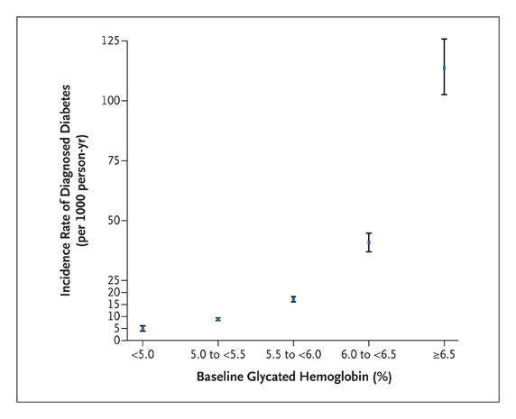
Pre-Diabetic Conditions:
Impact of Glycemic Control on Diabetes Risk
Prospective observational study of 11,092 patients without DM or CVD
The risk of DM increases with increasing HbA_{1C}
CVD=Cardiovascular disease, DM=Diabetes mellitus, HbA_{1C}=Glycosylated hemoglobin
Source: Selvin E et al. NEJM 2010;362:800-811

Slide 10
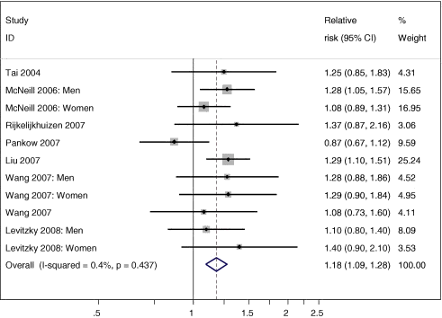
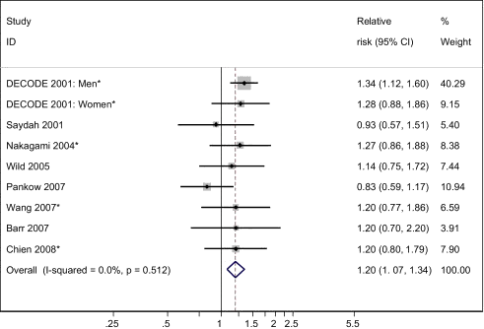
Pre-Diabetic Conditions:
Risk of Cardiovascular Disease
Meta-analysis of 18 clinical trials evaluating the risk of CV disease among patients with impaired fasting glucose and/or impaired glucose tolerance
Both types of pre-diabetic conditions increase the risk of CV disease
Impaired fasting glucose
Impaired glucose tolerance
CV=Cardiovascular
Source: Ford ES et al. JACC 2010;55:1310-1317
Notes:
This meta-analysis of 18 clinical trials sought to evaluate the risk of cardiovascular disease among patients with impaired fasting glucose and/or impaired glucose tolerance. Patients with both types of pre-diabetic conditions were noted to be at increased risk of cardiovascular disease. The RR of CV disease for impaired fasting glucose was 1.20 (95% CI, 1.12-1.28) when using a fasting glucose level of 110-125 mg/dl and 1.18 (95% CI, 1.09-1.28) when using a fasting glucose level of 100-125 mg/dl. The RR of CV disease for impaired glucose tolerance was 1.20 (95% CI, 1.07-1.34).

Slide 11
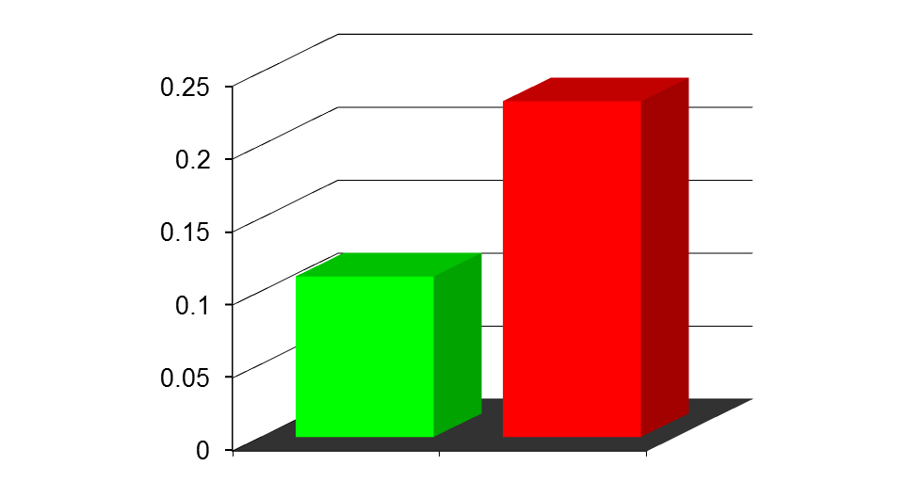
Pre-Diabetic Conditions:
Benefit of Lifestyle Modification
Finnish Diabetes Prevention Study
522 overweight and obese (mean BMI 31 kg/m²) patients with impaired fasting glucose† randomized to intervention‡ or usual care for 3 years
Lifestyle modification reduces the risk of developing diabetes mellitus
23%
Intervention
Control
% with Diabetes Mellitus
11%
†Defined as a glucose >140 mg/dl 2 hours after an oral glucose challenge
‡Aimed at reducing weight (>5%), total intake of fat (<30% total calories) and saturated fat (<10% total calories); increasing uptake of fiber (>15 g/1000 cal); and physical activity (moderate at least 30 min/day)
Source: Tuomilehto J et al. NEJM 2001;344:1343-1350
Notes:
The Finnish Diabetes Prevention Study sought to assess whether lifestyle modification could reduce the onset of diabetes mellitus in overweight and obese patients with impaired fasting glucose. A total of 522 patients were randomized to a program targeted at weight loss, reduced calorie intake, reduced saturated fat, and increased physical activity (30 minutes/day) vs. control for 3 years. The intervention arm significantly reduced the incidence of new onset diabetes mellitus (11% vs 23%).

Slide 12
Pre-Diabetic Conditions:
Benefit of Lifestyle Modification
Diabetes Prevention Program (DPP)
3,234 patients with elevated fasting and post-load glucose levels randomized to placebo, metformin (850 mg bid), or lifestyle modification* for 3 years
Lifestyle modification reduces the risk of developing DM
Placebo
Metformin
Lifestyle modification
40
*
30
20
Incidence of DM (%)
10
0
0
1
2
3
4
0
Years
*Includes 7% weight loss and at least 150 minutes of physical activity per week
DM=Diabetes mellitus
Source: Knowler WC et al. NEJM 2002;346:393-403
Notes:
The Diabetes Prevention Program randomized 3,234 patients with elevated fasting and post-load glucose levels to lifestyle modification, metformin (850 mg twice daily), or placebo for 3 years. Patients randomized to weight loss and physical activity (averaged to 22 minutes/day) had the lowest incidence of new onset diabetes mellitus and highlight the importance of structured lifestyle modification in at-risk individuals.

Slide 13
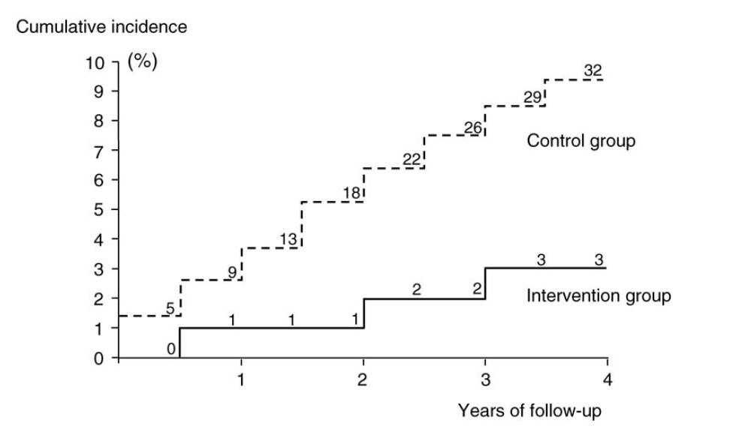
Pre-Diabetic Conditions:
Benefit of Lifestyle Modification
458 Japanese men with impaired glucose tolerance randomized to standard lifestyle intervention (goal BMI <24 kg/m²) or intensive lifestyle intervention (goal BMI <22 kg/m²)
More intensive lifestyle modification reduces the risk of DM
Cumulative incidence of DM (%)
Years
BMI=Body mass index, DM=Diabetes mellitus
Source: Kosaka K et al. Diabetes Res Clin Pract 2005;67:152-162
Notes:
A total of 458 Japanese men with impaired glucose tolerance were randomized to standard lifestyle intervention (control group) or intensive lifestyle intervention (intervention group) in a 4:1 ratio (356 in control group, 102 in intervention group). Subjects in the control group were advised to maintain a body mass index <24 kg/m2, while subjects in the intervention group were advised to maintain a body mass index <22 kg/m2 through changes in diet and exercise. Subjects in the intervention group received detailed lifestyle recommendations every 3-4 months. The cumulative incidence of diabetes mellitus during 4 years of follow-up was 9.3% in the control group and 3.0% in the intervention group (relative risk reduction 67.4%, p<0.001).

Slide 14
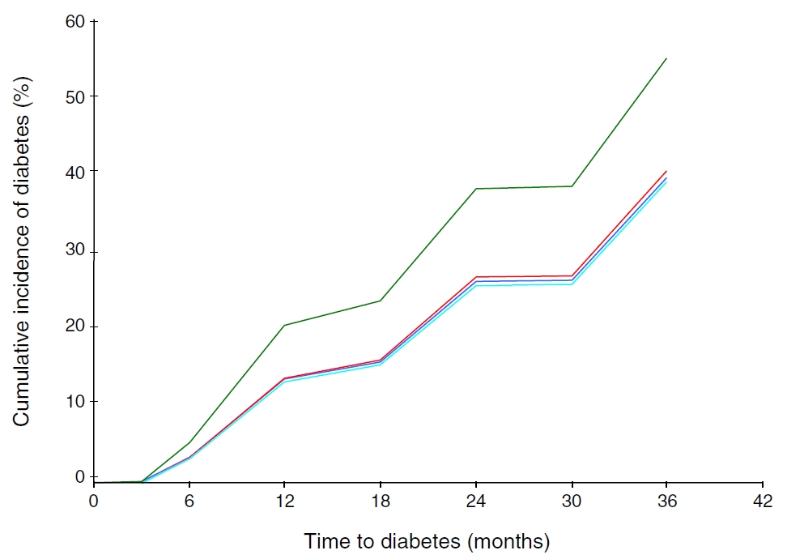
Pre-Diabetic Conditions:
Benefit of Lifestyle Modification
531 Asian Indians with impaired glucose tolerance randomized to placebo, metformin, lifestyle modification, or lifestyle modification plus metformin for 30 months
Lifestyle modification and metformin reduce the incidence of DM with no additional benefit from their combination
Control (55%)
Metformin (40.5%)
Lifestyle modification + metformin (39.5%)
Lifestyle modification (39.3%)
DM=Diabetes mellitus
Source: Ramachandran A et al. Diabetologia 2006;49:289-297
Notes:
The Indian Diabetes Prevention Programme sought to evaluate whether the development of diabetes mellitus in Asian Indians could be influenced by lifestyle modification and/or metformin. A total of 531 patients (421 men, 110 women) with impaired glucose tolerance (fasting plasma glucose <126 mg/dl and a 2 hour glucose level after a 75 g glucose load of 140-199 mg/dl) were randomized to placebo, metformin, lifestyle modification, or lifestyle modification plus metformin for a median follow-up of 30 months. The mean age was 46 years and the mean BMI was 26 kg/m2.
The 3-year cumulative incidences of diabetes mellitus were 55% in the control group, 40.5% in the metformin group, 39.5% in the lifestyle plus metformin group, and 39.3% in the lifestyle modification group. The relative risk reduction was 26.4% with metformin (95% CI 19.1-35.1, p=0.029), 28.2% with lifestyle modification plus metformin (95% CI 20.3-37.0, p=0.022), and 28.5% with lifestyle modification (95% CI 20.5-37.3, p=0.018). The number needed to treat to prevent one case of diabetes was 6.9 for metformin, 6.5 for lifestyle modification plus metformin, and 6.4 for lifestyle modification.
Overall: While lifestyle modification and metformin reduce the incidence of diabetes mellitus, there is no additional benefit from their combination.

Slide 15
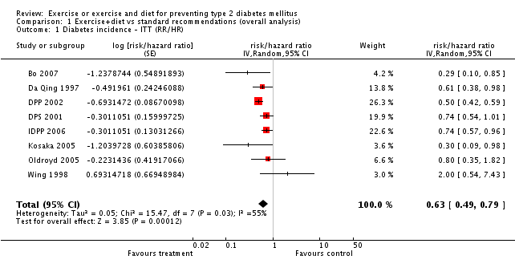
Pre-Diabetic Conditions:
Benefit of Lifestyle Modification
Meta-analysis of 8 clinical trials evaluating the impact of diet and exercise on the risk of diabetes mellitus among at risk* individuals
Lifestyle interventions among at risk* individuals reduce the risk of DM
*Includes individuals with impaired glucose tolerance or metabolic syndrome
DM=Diabetes mellitus
Source: Orozco LJ et al. Cochrane Database Syst Rev 2008;16:CD003054

Slide 16
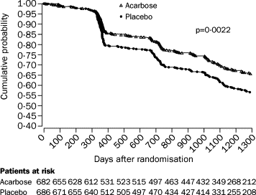
Pre-Diabetic Conditions:
Benefit of an Alpha-Glucosidase Inhibitor
Study to Prevent Non-Insulin Dependent DM (STOP-NIDDM) Trial
1,419 patients with IGT randomized to acarbose (100 mg TID) or placebo for 3.5 years
An alpha-glucosidase inhibitor reduces the risk of DM
DM=Diabetes mellitus, IGT=Impaired glucose tolerance
Source: Chiasson JL et al. Lancet 2002;359:2072-2077
Notes:
The Study to Prevent Non-Insulin Dependent DM (STOP-NIDDM) sought to evaluate whether an alpha-glucosidase inhibitor (acarbose) could reduce the onset of diabetes mellitus. A total of 1,149 patients with impaired glucose tolerance were randomized to acarbose (100 mg three times daily) or placebo for 3. 5 years. Treatment with acarbose was associated with a significant decrease in the onset of diabetes mellitus.

Slide 17
Pre-Diabetic Conditions:
Benefit of a Thiazolidinedione
Diabetes Reduction Assessment with Ramipril and Rosiglitazone Medication (DREAM) Trial
5,269 patients with IFG and/or IGT, but without known CVD randomized to rosiglitazone (8 mg) or placebo for a median of 3 years
0.6
Placebo
Rosiglitazone
0.4
Incident DM or Death
0.2
60% RRR, P<0.0001
0.0
0
1
2
3
4
Years
A thiazolidinedione reduces the risk of DM or death
CVD=Cardiovascular disease, DM=Diabetes mellitus, IFG=Impaired fasting glucose, IGT=Impaired glucose tolerance
Source: Gerstein HC et al. Lancet 2006;368:1096-1105
Notes:
The DREAM trial sought to evaluate whether a thiazolidinedione could prevent type 2 diabetes mellitus in at risk individuals as compared to placebo. A total of 5,269 patients with impaired fasting glucose and/or impaired glucose tolerance were randomized to rosiglitazone (8 mg daily) or placebo for a median of 3 years. Treatment with rosiglitazone resulted in a significant reduction in the primary end point of incident diabetes or death (11.6% vs 26.0%, HR 0.40, 95% CI 0.35-0.46; p<0.0001). There was not, however, a significant reduction in the cardiovascular event rate.

Slide 18
Pre-Diabetic Conditions:
Benefit of a Thiazolidinedione
ACT NOW Study
602 patients with impaired glucose tolerance + impaired fasting glucose randomized to pioglitazone (45 mg) or placebo for 2.4 years
A thiazolidinedione reduces the risk of DM
72% RRR
9
7.6
6
Conversion to DM* (%/year)
3
2.1
P<0.001
0
Placebo
Pioglitazone
*Defined as a fasting glucose measurement >126 mg/dL or a glucose level of >200 mg/dL following an OGTT with repeat OGTT for confirmation
DM=Diabetes mellitus, OGTT=Oral glucose tolerance test, RRR=Relative risk reduction
Source: DeFronzo RA et al. NEJM 2011;364:1104-1115
Notes:
In the Actos Now Study for the Prevention of Diabetes (ACT NOW), 602 patients with impaired glucose tolerance and at least one other high risk characteristic were randomized to pioglitazone (45 mg/day) or placebo. High risk characteristics included: (i) one or more components of insulin resistance (low HDL cholesterol [<40 mg/dl in females; <35 mg/dl in males], fasting plasma triglyceride ≥ 150 mg/dl, sitting blood pressure > 135/85 mmHg or on active therapy for hypertension, BMI ≥ 25 kg/m2 [BMI ≥ 22 kg/m2 for Asian Americans], waist circumference > 102 cm in men and > 88 cm in women [>90 cm in Asian American men and > 80 cm in Asian American women]), (ii) a family history of type 2 diabetes mellitus (≥1 first degree relatives); (iii) a history of gestational diabetes mellitus; (iv) polycystic ovarian syndrome; or (v) a minority ethnic background (Mexican American, African American, Asian, Pacific Islander, Native American). Participants had an abnormal oral glucose tolerance test (2 hour plasma glucose level of 140-199 mg/dl) and fasting plasma glucose level (95-125 mg/dl).

Slide 19
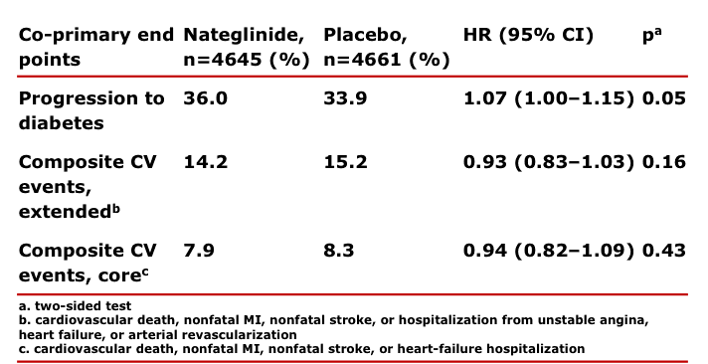
Pre-Diabetic Conditions:
Lack of Benefit of an Insulin Secretagogue
Nateglinide and Valsartan in Impaired Glucose Tolerance
Outcomes Research (NAVIGATOR) Trial
9,306 patients with IFG and CVD or CV risk factors randomized in a 2 x 2 trial to valsartan (160 mg), nateglidine (60 mg TID), or placebo for 6.5 years
An insulin secretagogue does not reduce the risk of DM or CV events
CV=Cardiovascular, CVD=Cardiovascular disease,
DM=Diabetes mellitus, IFG=Impaired fasting glucose
Source: NAVIGATOR Study Group. NEJM 2010;362:1463-1476
Notes:
In the Nateglinide and Valsartan in Impaired Glucose Tolerance Outcomes Research (NAVIGATOR) trial, 9,306 patients with impaired fasting glucose and cardiovascular disease or cardiovascular risk factors were randomized in a 2 x 2 factorial trial to valsartan (160mg), nateglinide (60mg TID) or placebo for an average of 6.5 years. Treatment with nateglinide did not reduce the risk of diabetes or cardiovascular events.

Slide 20
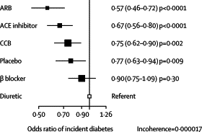
Risk of Developing Diabetes Mellitus
Among Different Antihypertensive Agents
Systematic review of 22 clinical trials evaluating 143,153 patients without DM randomized to an antihypertensive agent
Treatment with an ARB or ACE inhibitor carries the lowest risk of developing DM
ACE=Angiotensin converting enzyme, ARB=Angiotensin receptor blocker, DM=Diabetes mellitus
Source: Elliott WJ et al. Lancet 2007;369:201-207
Notes:
This meta-analysis of 22 clinical trials with 143,153 participants sought to assess the differential effect of antihypertensive agents on the risk of developing diabetes mellitus. Patients treated with an ARB or ACE inhibitor carried the lowest risk of developing diabetes. In contrast, patients treated with a diuretic or β-blocker carried the highest risk of developing diabetes.

Slide 21
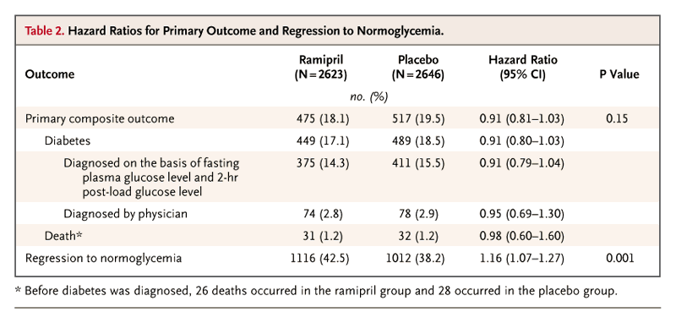
Pre-Diabetic Conditions:
Lack of Benefit of an ACE Inhibitor
Diabetes Reduction Assessment with Ramipril and Rosiglitazone Medication (DREAM) Trial
5,269 patients with IFG and/or IGT, but without known CVD randomized to ramipril (up to 15 mg) or placebo for a median of 3 years
An ACE inhibitor does not reduce the risk of DM or death
ACE=Angitoensin converting enzyme, CVD=Cardiovascular disease, DM=Diabetes mellitus, IFG=Impaired fasting glucose, IGT=Impaired glucose tolerance
Source: DREAM Trial Investigators. NEJM 2006;355:1551-1562
Notes:
Patients in the DREAM trial were also randomized to receive ramipril or placebo (in addition to rosiglitazone or placebo) in a 2 X 2 factorial design. Unlike with rosiglitazone, treatment with rampiril did not significantly reduce the risk of diabetes or death during the same duration of follow-up.

Slide 22
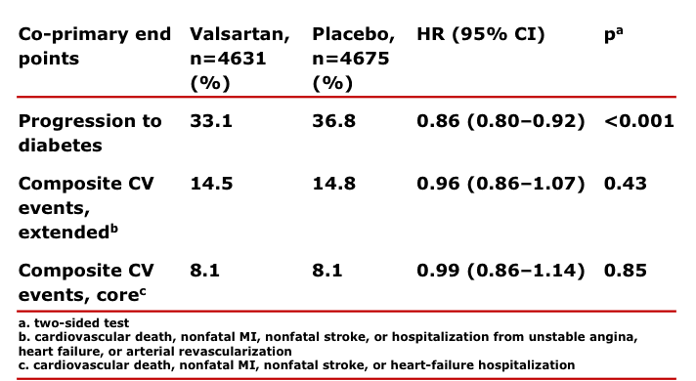
Pre-Diabetic Conditions:
Benefit of an Angiotensin Receptor Blocker
Nateglinide and Valsartan in Impaired Glucose Tolerance
Outcomes Research (NAVIGATOR) Trial
9,306 patients with IFG and CVD or CV risk factors randomized in a 2 x 2 trial to valsartan (160 mg), nateglidine (60 mg TID), or placebo for 6.5 years
An ARB does reduce the risk of DM, but not CV events
ARB=Angiotensin receptor blocker, CV=Cardiovascular, CVD=Cardiovascular disease, DM=Diabetes mellitus, IFG=Impaired fasting glucose
Source: NAVIGATOR Study Group. NEJM 2010;362:1477-1490
Notes:
In the Nateglinide and Valsartan in Impaired Glucose Tolerance Outcomes Research (NAVIGATOR) trial, 9,306 patients with impaired fasting glucose and cardiovascular disease or cardiovascular risk factors were randomized in a 2 x 2 factorial trial to valsartan (160mg), nateglinide (60mg TID) or placebo for an average of 6.5 years. Unlike with nateglinide, treatment with valsartan did decrease the risk of progression to diabetes (HR=0.86, p<0.001). It did not, however, decrease the risk of cardiovascular events.

Slide 23
Pre-Diabetic Conditions:
Lack of Benefit of Insulin Glargine
Outcome Reduction with Initial Glargine Intervention (ORIGIN)
12,536 patients with IFG, IGT, DM, established CV disease, or CV risk factors randomized in 2 x 2 trial design to omega 3 fatty acids (at least 900 mg/day), insulin glargine (with a target fasting blood glucose <95 mg/dL) or placebo for a median of 6.2 years
Insulin glargine did not provide CV benefit in at risk individuals
4
3
2.85
2.94
Event rate for the primary end point per 100 patient years*
2
P=0.63
0
Placebo
Insulin glargine
*Composite of nonfatal myocardial infarction, nonfatal stroke, death from cardiovascular causes, revascularization, or hospitalization for heart failure
CV=Cardiovascular, DM=Diabetes mellitus, IFG=Impaired fasting glucose, IGT=Impaired glucose tolerance
Source: ORIGIN Trial Investigators. NEJM 2012;367:319-328

Slide 24
Evidence for Current Cardiovascular Disease
Prevention Guidelines
Metabolic Syndrome

Slide 25
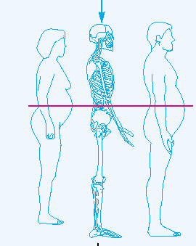
Metabolic Syndrome
Consists of a constellation of major risk factors, life-habit risk factors, and emerging risk factors
Over-represented among
populations with CVD
Often occurs in individuals with a distinctive body-type including an increased abdominal circumference
Notes:
Metabolic syndrome is a multiplex risk factor for cardiovascular disease and type 2 diabetes mellitus. It reflects the clustering of individual risk factors due to abdominal obesity and insulin resistance, including the interrelated metabolic risk conditions of atherogenic dyslipidemia, glucose intolerance, elevated blood pressure, a proinflammatory state, and a prothrombotic state. Atherogenic dyslipidemia is itself an aggregate term comprised of elevated fasting and nonfasting triglycerides, elevated VLDL-C, reduced HDL-C, and an atherogenic small dense LDL-C phenotype.

Slide 26
Adult Treatment Panel III
Definition of Metabolic Syndrome
Defined by the presence of >3 risk factors
Risk Factor | Defining Level
Waist circumference (abdominal obesity) | >40 in (>102 cm) in men
 | >35 in (>88 cm) in women
Triglyceride level | >150 mg/dl
HDL-C level | <40 mg/dl in men
 | <50 mg/dl in women
Blood pressure | >130/>85 mmHg
Fasting glucose | >110 mg/dl
HDL-C=High-density lipoprotein cholesterol
Source: Expert Panel on Detection, Evaluation, and Treatment of High Blood Cholesterol in Adults. JAMA 2001;285:2486-2497
Notes:
This slide lists the most recent ATP III criteria for defining metabolic syndrome.

Slide 27
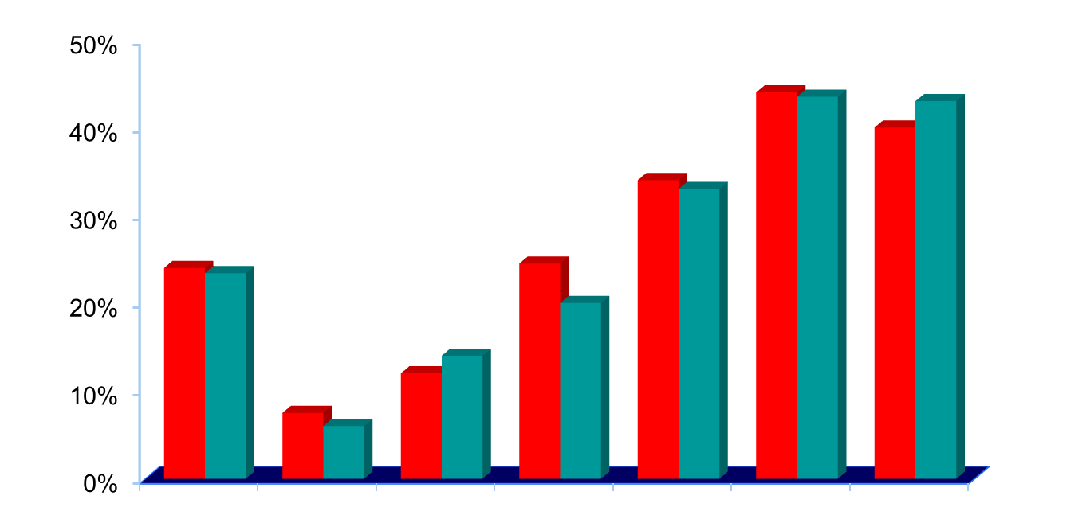
Metabolic Syndrome:
Prevalence in the United States
National Health and Nutrition Examination Survey (NHANES)
Men
Women
Prevalence, %
20–70+
20–29
30–39
40–49
50–59
60–69
≥70
Age (Years)
Source: Ford ES et al. JAMA 2002;287:356-359
Notes:
This slide shows the prevalence of metabolic syndrome by age as defined by ATP III criteria in NHANES III. While the overall prevalence of metabolic syndrome in the U.S. is about 24%, there is marked variation depending on one’s age. The prevalence of metabolic syndrome is <10% in individuals aged 20–29 years, 20% in individuals aged 40–49 years, and 45% in individuals aged 60–69 years.

Slide 28
Metabolic Syndrome:
Risk of Diabetes Mellitus
Framingham Offspring Study
Prospective observational study of 3,323 middle-aged adults followed for 8 years to assess the development of diabetes mellitus
Individuals with metabolic syndrome are at increased risk for developing DM
Gender | Number of events/ nonevents among those without metabolic syndrome present | Number of events/ nonevents among those with metabolic syndrome present | Relative risk (95% CI) | Age-adjusted p-value | Population attributable risk, %
Men | 28/1106 | 71/344 | 6.92 (4.47–10.81) | <0.0001 | 61.5
Women | 33/1446 | 46/249 | 6.90 (4.35–10.94) | <0.0001 | 46.9
DM=Diabetes mellitus
Source: Wilson PW et al. Circulation 2005;112:3066-3072
Notes:
In the Framingham Offspring Study, 3,323 middle-aged adults (22 to 81 years old) were followed for 8 years to assess the development of diabetes mellitus. The incidence of metabolic syndrome (as defined by ATP III criteria) in those without type II diabetes or cardiovascular disease was 16.6% in women and 26.8% in men. Metabolic syndrome was associated with a significantly increased risk for diabetes in both men and women alike.

Slide 29
Metabolic Syndrome:
Risk of Diabetes Mellitus
San Antonio Heart Study
Prospective observational study of 2,941 non-diabetic Mexican American and non-Hispanic Caucasian individuals followed for 7.4 years to assess the development of diabetes mellitus
Individuals with metabolic syndrome are at increased risk for developing DM
Fasting glucose level | ATP III metabolic syndrome | OR (95% CI)
Normal | No | Referent
Normal | Yes | 5.03 (3.39–7.48)
Impaired fasting glucose | No | 7.07 (3.32–15.1)
Impaired fasting glucose | Yes | 21.0 (13.1–33.8)
ATP=Adult Treatment Panel, DM=Diabetes mellitus, OR=Odds ratio
Source: Lorenzo C et al. Diabetes Care 2007;30:8-13
Notes:
The San Antonio Heart Study evaluated the incidence of diabetes mellitus in patients with and without metabolic syndrome and/or impaired fasting glucose. A total of 2,941 non-diabetic Mexican American and non-Hispanic Caucasian individuals between the ages of 25-64 years old were enrolled. Incident diabetes was assessed in 1,709 of 2,459 (69.5%) non-diabetic participants who were alive at follow-up. A total of 195 subjects (11.4%) developed diabetes during 7.4 years of average follow-up. Metabolic syndrome (according to either the ATP III definition or the International Diabetes Federation definition) predicted an increased risk of incident diabetes during follow-up beyond that predicted by impaired fasting glucose alone.

Slide 30
Metabolic Syndrome:
Risk of Coronary Heart Disease*
National Health and Nutrition Examination Survey (NHANES)
19.2%
13.9%
CHD Prevalence
8.7%
7.5%
No MS/No DM
MS/No DM
DM/No MS
DM/MS
54%
29%
2%
15%
% of Population
*Among individual >50 years
CHD=Coronary heart disease, DM=Diabetes mellitus, MS=Metabolic syndrome
Source: Alexander CM et al. Diabetes 2003;52:1210-1214
Notes:
Metabolic syndrome is associated with an increased prevalence of coronary heart disease. Among individuals with metabolic syndrome and diabetes mellitus, the prevalence of coronary heart disease is even greater.

Slide 31
Metabolic Syndrome:
Risk of Death
National Health and Nutrition Examination Survey (NHANES)
4
CVD*
3
CHD†
Mortality hazard ratio
2
1
0
0
1
2
3
4
5
Number of Metabolic Syndrome Criteria
Risk of death is proportional to the number of ATP III criteria met for metabolic syndrome
*Adjusted for age, sex, race or ethnicity, education, smoking status, non–HDL-C level, recreational and non-recreational activity, white blood cell count, alcohol use, prevalent heart disease, and stroke
†Similar adjustments except for prevalent stroke
CHD=Coronary heart disease, CVD=Cardiovascular disease
Source: Ford ES. Atherosclerosis 2004;173:309-314
Notes:
31
The risk of death from CV disease increases in proportion to the number of metabolic syndrome criteria met.

Slide 32
Evidence for Current Cardiovascular Disease
Prevention Guidelines
Diabetes Mellitus

Slide 33
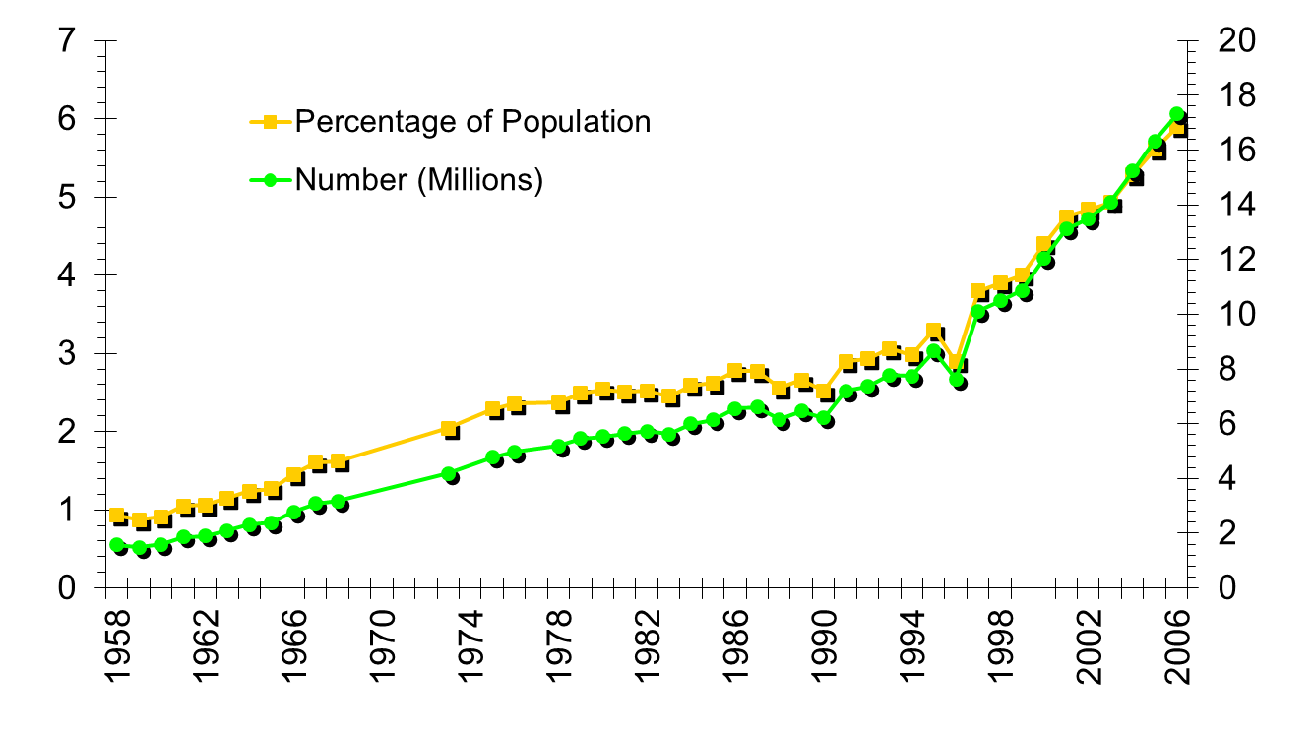
Diabetes Mellitus:
Prevalence in U.S. Adults
Percentage and absolute numbers of diabetics in the United States
Source: Centers for Disease Control and Prevention, Division of Diabetes Translation National Diabetes Surveillance System. Available at http://www.cdc.gov/diabetes/statistic
Notes:
Since 1958, the non-institutionalized U.S. population has been sampled annually through interviews of 36,000 to 49,000 randomly selected households. Data from the National Health Interview Survey reveal a steady increase in both the prevalence rate and number of people with a diagnosis of diabetes mellitus. Explanations for this include: an aging U.S. population with higher rates of diabetes at older ages; a reduction in mortality among people with diabetes; and modifications of the criteria used to diagnose diabetes. These explanations may account for some of the increase in the prevalence rate; however, the growing number of overweight and physically inactive individuals likely plays a significant role as well.

Slide 34
Diabetes Mellitus:
State-specific Prevalence in U.S. Adults
2006 CDC BRFSS Data
4%-6%
6-8%
8-10%
10-12%
≥12%
Source: CDC BRFSS 2006 Data, Available at: http://apps.nccd.cdc.gov/brfss/list.asp?cat=DB&yr=2006&qkey=1363&state=All
Notes:
The prevalence of diabetes mellitus varies widely by state.

Slide 35
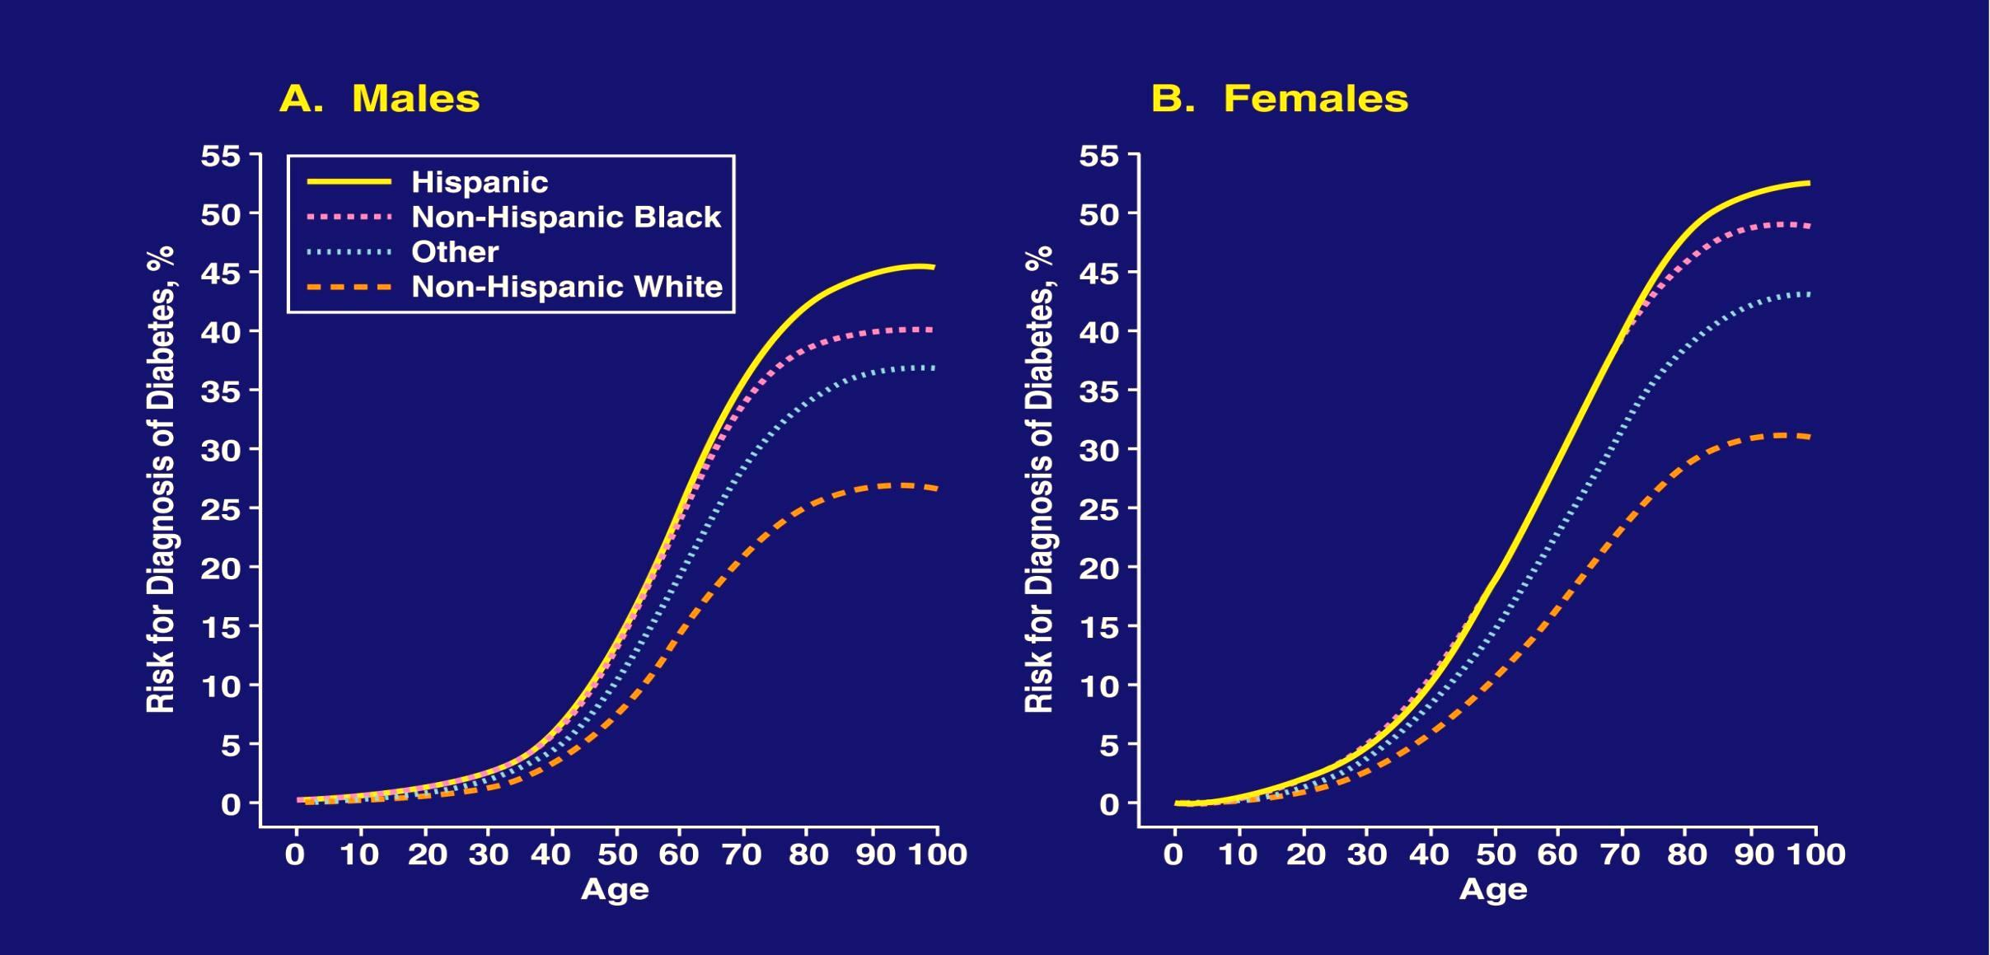
Diabetes Mellitus:
Lifetime Risk
Source: Narayan et al. JAMA 2003;290:1884-1890
Notes:
35
Advancing age is a strong predictor of developing diabetes mellitus in men and women alike.

Slide 36
Mechanisms by which Diabetes Mellitus
Leads to Coronary Heart Disease
Hyperglycemia
Insulin Resistance
↑ AGE
↑ Oxidative
stress
HTN
Endothelial
dysfunction
Inflammation
Dyslipidemia
↑ IL-6
↑ CRP
↑ SAA
↑ LDL
↑ TG
↓ HDL
Infection
Thrombosis
↓ Defense
mechanisms
↑ Pathogen burden
↑ PAI-1
↑ TF
↓ tPA
Subclinical Atherosclerosis
Disease Progression
Atherosclerotic Clinical Events
AGE=Advanced glycation end products, CRP=C-reactive protein, CHD=Coronary heart disease HDL=High-density lipoprotein, HTN=Hypertension, IL-6=Interleukin-6, LDL=Low-density lipoprotein, PAI-1=Plasminogen activator inhibitor-1, SAA=Serum amyloid A protein, TF=Tissue factor, TG=Triglycerides, tPA=Tissue plasminogen activator
Source: Biondi-Zoccai GGL et al. JACC 2003;41:1071-1077
Notes:
36
Infection, inflammation, hyperglycemia, insulin resistance, dyslipidemia, and thrombosis have all been implicated in the development of atherosclerosis and subsequent adverse CV events in patients with diabetes mellitus.

Slide 37
Diabetes Mellitus:
Risk of Myocardial Infarction
East-West Study
50
45
DM
No DM
40
30
Events*/100 person-years
20
19
20
10
3.5
0
Prior CHD
No prior CHD
Patients with DM but no CHD experience a similar rate of MI as patients without DM but with CHD
*Fatal or non-fatal MI
CHD=Coronary heart disease, DM=Diabetes mellitus, MI=Myocardial infarction
Source: Haffner SM et al. NEJM 1998;339:229–234
Notes:
The East-West Study evaluated the 7-year incidence of myocardial infarction among 1,059 diabetic subjects and 1,373 non-diabetic subjects enrolled in a Finnish population-based prospective cohort study. The 7-year incidence of MI in diabetic subjects was 45.0% among those with a history of MI and 20.2% among those with no history of MI (p<0.001). The 7-year incidence of MI in non-diabetic subjects was 18.8% in those with a history of MI and 3.5% in those with no history of MI (p<0.001). The East-West Study highlights diabetes mellitus as a coronary artery disease risk equivalent.

Slide 38
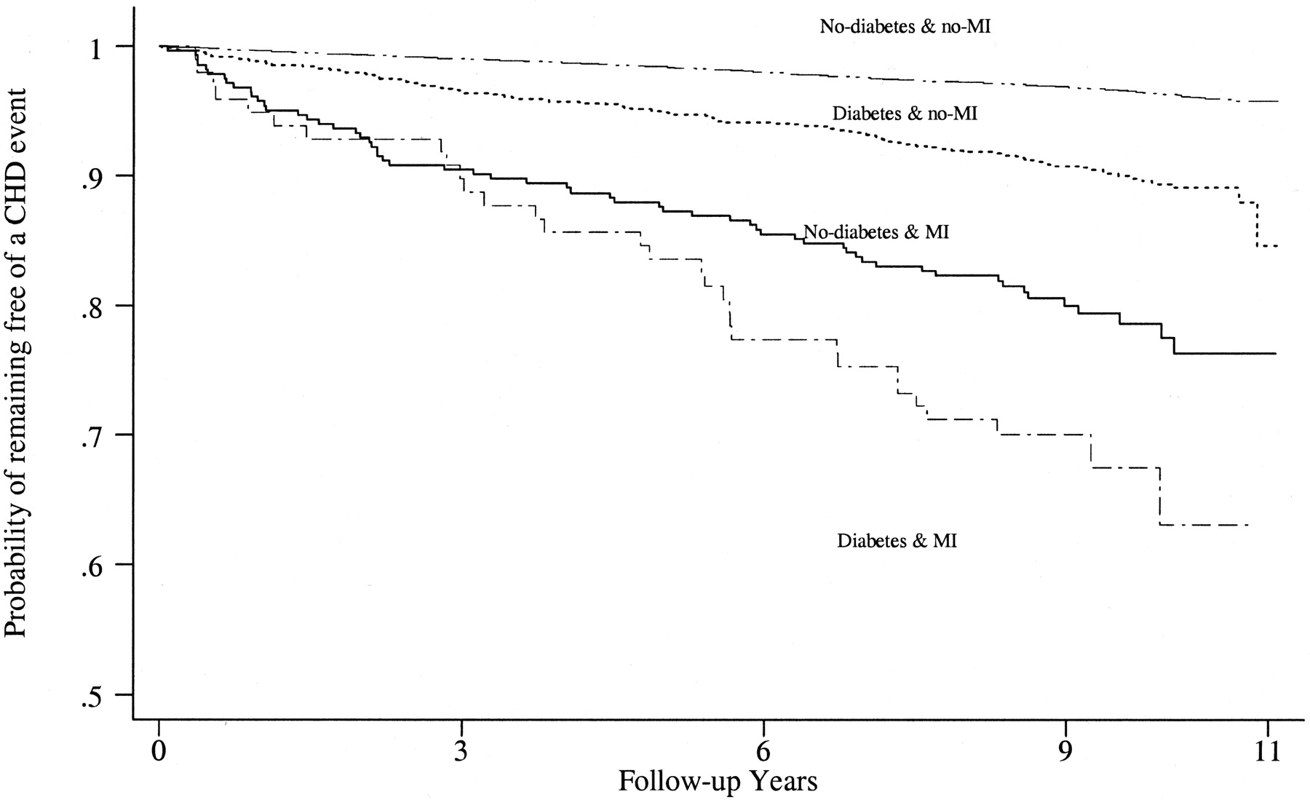
Diabetes Mellitus:
CHD Risk Following a Myocardial Infarction
Prospective observational study of 13,790 patients to assess the risk of CHD events among those with and without a history of DM and/or MI
Diabetics with prior MI have the highest CHD risk
CHD=Coronary heart disease, DM=Diabetes mellitus, MI=Myocardial infarction
Source: Lee CD et al. Circulation 2004;109:855-60

Slide 39
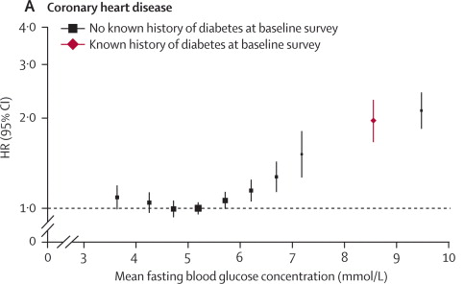
Diabetes Mellitus:
Risk of Cardiovascular Events
Meta-analysis of 102 clinical trials evaluating the risk of coronary heart disease events based on fasting blood glucose concentration
A non-linear relationship exists between fasting blood glucose and CV risk
CV=Cardiovascular
Source: Emerging Risk Factors Collaboration. Lancet 2010;375:2215-2222

Slide 40
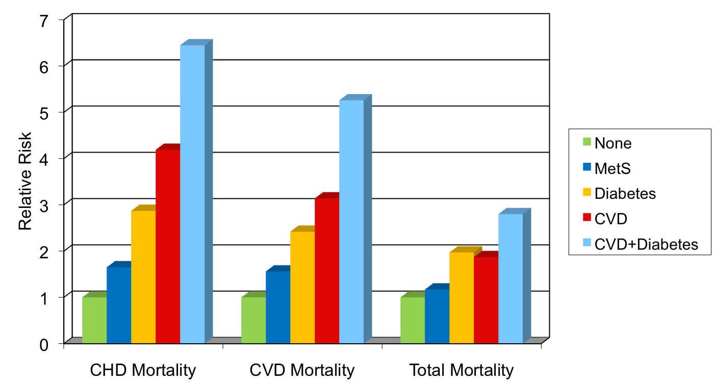
Diabetes Mellitus:
Risk of Cardiovascular Events and Death
U.S. adults aged 30-74 years
***
***
***
***
***
***
***
***
***
*
**
*p<.05 compared to none, **p<.01 compared to none, ***p<.0001 compared to none
CHD=Coronary heart disease, CVD=Cardiovascular disease, MetS=Metabolic syndrome
Source: Malik S et al. Circulation 2004;110:1245-1250
Notes:
This study evaluated the impact of metabolic syndrome on CHD, CVD, and overall mortality among US adults. A total of 6255 subjects 30 to 75 years of age (54% female) from the 2nd National Health and Nutrition Examination Survey were followed for a mean of 13.3 years. Metabolic syndrome was defined by the ATP III criteria. Compared to those with neither metabolic syndrome nor prior CVD, age-, gender-, and risk factor-adjusted hazard ratios (HRs) for CHD mortality were 2.02 (95% CI, 1.42 to 2.89) for those with metabolic syndrome and 4.19 (95% CI, 3.04 to 5.79) for those with pre-existing CVD. For CVD mortality, HRs were 1.82 (95% CI, 1.40 to 2.37) and 3.14 (95% CI, 2.49 to 3.96), respectively; for overall mortality, HRs were 1.40 (95% CI, 1.19 to 1.66) and 1.87 (95% CI, 1.60 to 2.17), respectively.
Overall: In persons with metabolic syndrome but without diabetes, risks of CHD and CVD mortality remained elevated. The presence of diabetes, however, predicted all mortality end points.

Slide 41
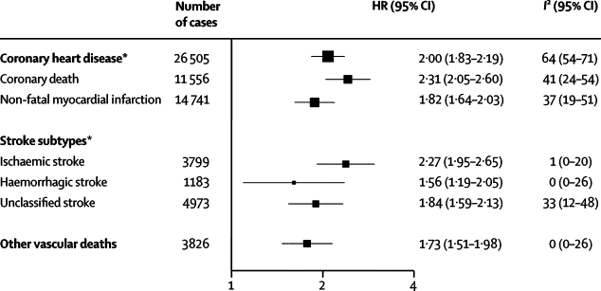
Diabetes Mellitus:
Risk of Cardiovascular Events and Death
Meta-analysis of 102 clinical trials evaluating the risk of cardiovascular events due to diabetes mellitus
Diabetes mellitus significantly increases the risk of adverse CV events
CV=Cardiovascular
Source: Emerging Risk Factors Collaboration. Lancet 2010;375:2215-2222

Slide 42
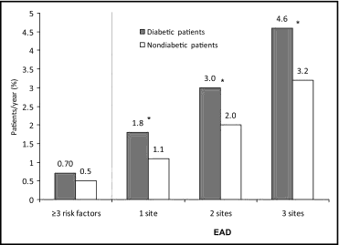
Diabetes Mellitus:
Risk of Cardiovascular Events and Death
Reduction of Atherothrombosis for Continued Health (REACH) Registry
Prospective registry of patients with or without DM along with CV risk factors or established atherothrombotic disease
Patients with DM face increased CV risk related to the number of affected sites
*
*Composite of CV death, myocardial infarction, and stroke
CV=Cardiovascular, DM=Diabetes mellitus, EAD=Established atherothrombotic disease
Source: Krempf M et al. Am J Cardiol 2010;105:667-671
Notes:
This study sought to determine the rate of CV events in diabetic and non-diabetic subjects from the REACH Registry (an international prospective cohort of patients with established coronary artery disease, cerebrovascular disease, peripheral arterial disease, or multiple risk factors for atherothrombosis). Among the 30,043 individuals with diabetes mellitus, the MACE (cardiovascular death, myocardial infarction, stroke, major adverse cardiovascular events) rate at 1 year was positively related to the number of atherothrombotic anatomic sites, and the rate was higher in those with (3.8%) than without (3.0%, p <0.001) diabetes. Diabetic patients with risk factors only had a lower MACE rate than nondiabetic subjects or diabetic patients with established atherothrombotic disease (2.2% vs 4.0% or 6.0%, respectively, p <0.001 for the 2 comparisons).

Slide 43
Diabetes Mellitus:
Risk of Death
East-West Study
100
80
60
Survival (%)
Nondiabetic subjects without prior MI
Diabetic subjects without prior MI
Nondiabetic subjects with prior MI
Diabetic subjects with prior MI
40
20
0
1
2
3
4
5
6
7
8
Years
Patients with DM but no CHD experience a similar rate of death as patients without DM but with CHD
CHD=Coronary heart disease, DM=Diabetes mellitus, MI=Myocardial infarction
Source: Haffner SM et al. NEJM 1998;339:229–234
Notes:
The East-West Study evaluated 1,059 diabetic subjects and 1,373 non-diabetic subjects enrolled in a Finnish population-based prospective cohort study. The hazard ratio for CHD death in diabetic subjects with no history of a MI was similar to that of nondiabetic subjects with a history of a MI (HR=1.4, 95% CI 0.7-2.6). The East-West Study highlights diabetes mellitus as a coronary artery disease risk equivalent.

Slide 44
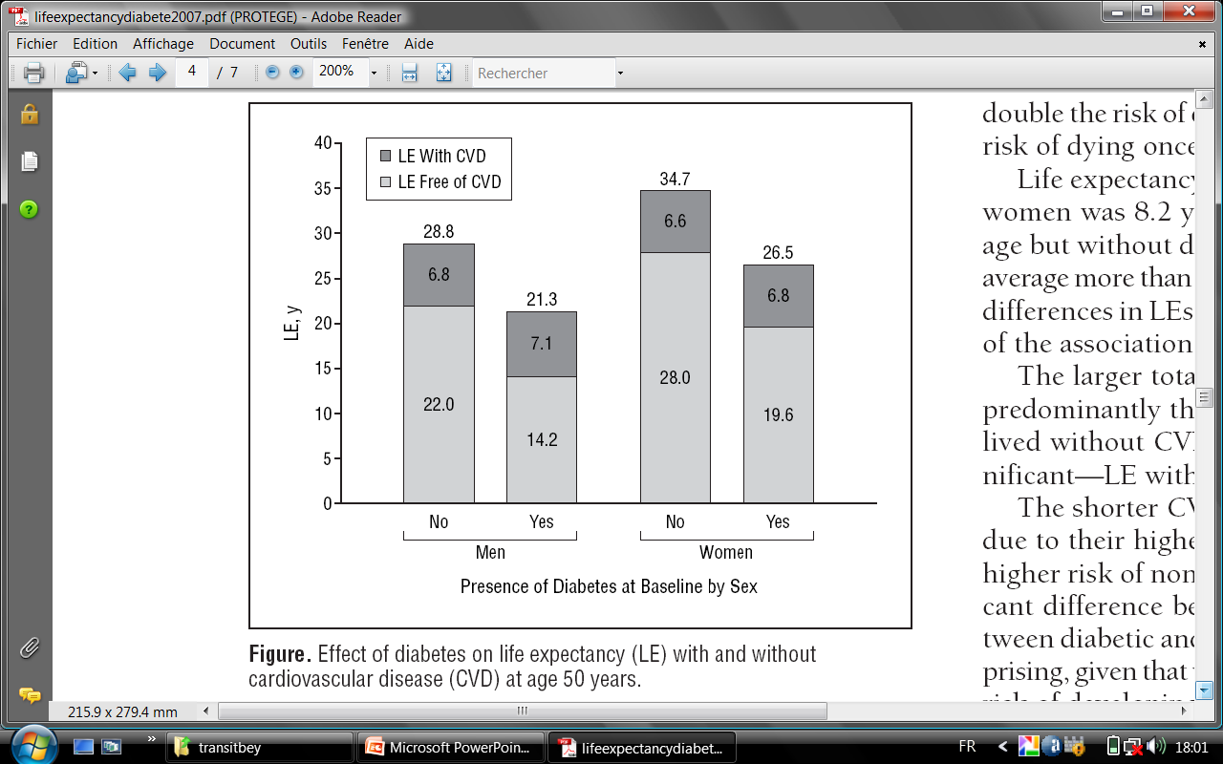
Diabetes Mellitus:
Life Expectancy
Framingham Heart Study
Life tables constructed among patients >50 years to assess the relationship between DM and life expectancy among those with and without CV disease
DM results in an important decrease in CV disease free life expectancy
CV=Cardiovascular, CVD=Cardiovascular disease, DM=Diabetes mellitus, LE=Life expectancy
Source: Franco OH et al. Arch Intern Med 2007;167:1145-1151
Notes:
Life tables constructed from the Framingham Heart Study suggest that patients with diabetes mellitus have decreased CV disease-free life expectancy.

Slide 45
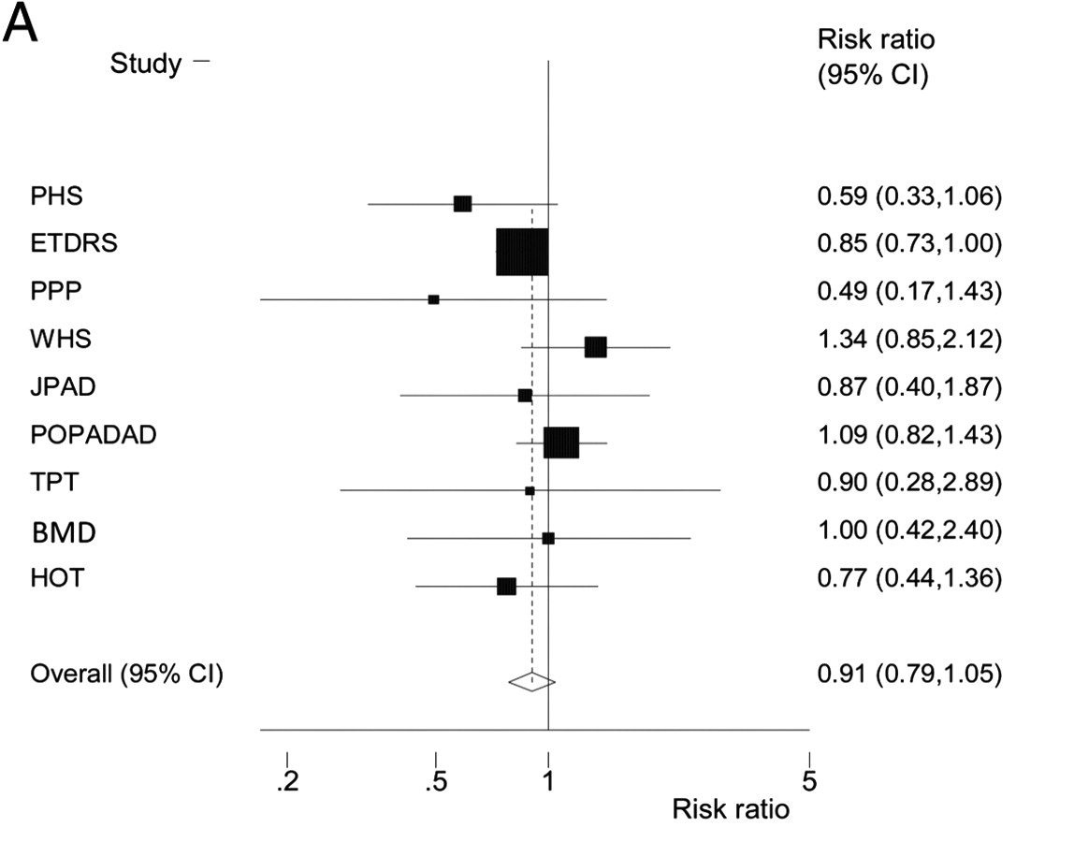
Diabetes Mellitus:
Effect of Aspirin
Meta-analysis of 9 clinical trials evaluating the effect of aspirin on cardiovascular events among patients with diabetes mellitus
Aspirin does not provide cardiovascular benefit in diabetics
Source: Pignone M et al. JACC 2010;55:2878-2886

Slide 46
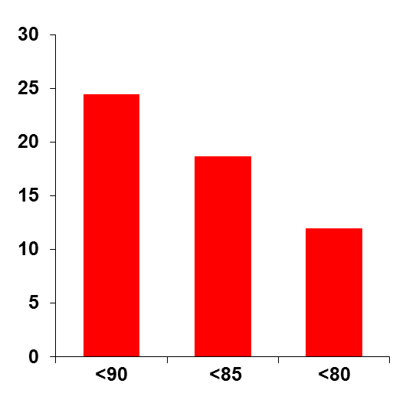
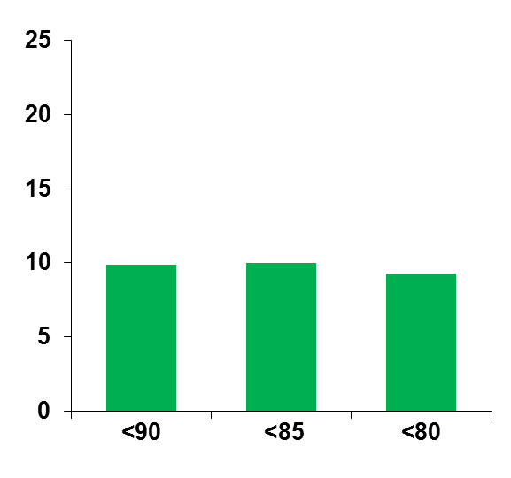
Diabetes Mellitus:
Effect of Blood Pressure Control
Hypertension Optimal Treatment (HOT) Study
18,790 patients with a baseline diastolic BP of 100-115 mm Hg randomized to a target diastolic BP of <90 mm Hg, <85 mm Hg, or <80 mm Hg
There is greater benefit with more intensive BP control in diabetics
Patients with
Diabetes
Patients without
Diabetes
Major CV events per
1000 patient-years
Diastolic BP goal
Diastolic BP goal
BP=Blood pressure, CV=Cardiovascular
Source: Hansson L et al. Lancet 1998;351:1755-1762
Notes:
The importance of reducing diastolic BP in patients with diabetes mellitus was demonstrated in the Hypertension Optimal Treatment (HOT) trial. In the HOT trial, 18,790 patients with hypertension and a diastolic BP between 100 and 115 mm Hg were randomized to 1 of 3 target diastolic BP groups: ≤90 mm Hg, ≤85 mm Hg, or ≤80 mm Hg. A subgroup of 1501 patients had DM at baseline. A 5-step treatment regimen that started with felodipine was used to lower BP. At the study end, 78% of patients were still taking felodipine, usually with an angiotensin converting enzyme inhibitor (41%) or a β-blocker (28%).
The incidence of major CV events (MI, stroke, CV mortality) did not differ significantly among the 3 target BP groups in patients who did not have diabetes. Events per 1000 patient-years were 9.9, 10.0, and 9.3 for the ≤90 mm Hg, ≤85 mm Hg, or ≤80 mm Hg groups, respectively. In patients with diabetes mellitus, however, there was a 51% reduction in major CV events in the target group ≤80 mm compared with target group ≤90 mm (P for trend = .005). Events per 1000 patient-years were 24.4, 18.6, and 11.9 (P=0.005 for trend) for those with diabetes in the ≤90 mm Hg, ≤85 mm Hg, or ≤80 mm Hg groups, respectively.

Slide 47
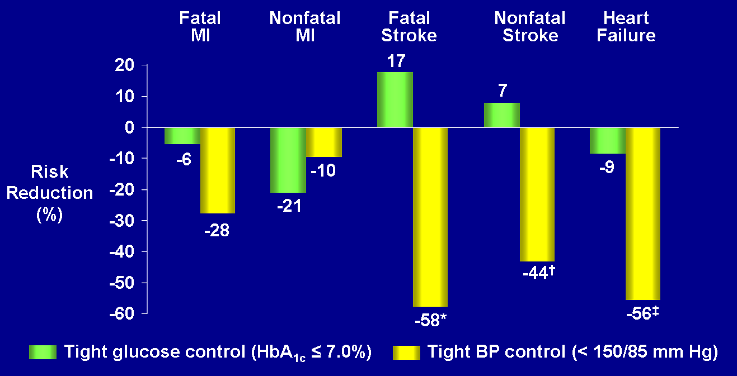
Diabetes Mellitus:
Effect of Blood Pressure Control
United Kingdom Prospective Diabetes Study (UKPDS)
BP control yields greater CV risk reduction than glycemic control
*P=0.04, †P=0.029, ‡P=0.04 vs less tight BP control (<180/105 mm Hg)
BP=Blood pressure, CV=Cardiovascular, MI=Myocardial infarction
Sources:
UKPDS 38. BMJ 1998;317:703-713
UKPDS 33. Lancet 1998;352:837-853
Notes:
In the United Kingdom Prospective Diabetes Study (UKPDS), tight blood pressure control was associated with greater CV risk reduction compared to tight glycemic control.

Slide 48
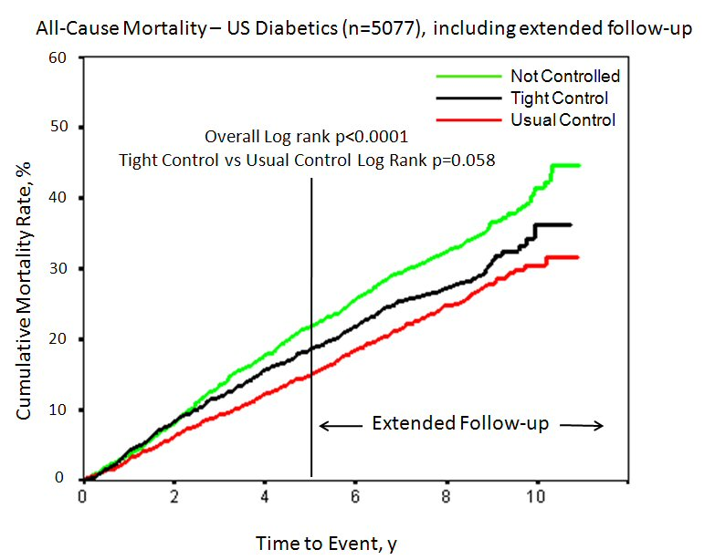
Diabetes Mellitus:
Effect of Blood Pressure Control
International Verapamil-Trandolapril Study (INVEST)-DM Substudy
6,400 diabetic patients from the INVEST study grouped by tight (<130 mm Hg), usual (>130 to <140 mm Hg), or uncontrolled (>140 mm Hg) blood pressure
Cumulative Mortality Rate %
HR=1.15, p=0.036
Time to Event, y
Tight BP control is not associated with reduced adverse CV events
BP=Blood pressure, CV=Cardiovascular, DM=Diabetes mellitus
Source: Cooper-DeHoff RM et al. JAMA 2010;304:61-68
Notes:
In this substudy of the original INVEST study, 6400 patients with diabetes and CAD were randomized to two blood-pressure lowering strategies including long acting verapamil or atenolol. Additional BP lowering could be achieved through the addition of trandolopril and HCTZ. The target was a blood pressure of less than 130/85 mm Hg.
In the current analysis, patients were categorized according to the degree of blood-pressure control actually achieved. Patients with a systolic blood pressure of 140 mm Hg or higher were classified as "not controlled." Those with a systolic blood pressure below 130 mm Hg were classified as "tight control" and those with a systolic blood pressure between 130 and 140 mm Hg were classified as "usual control.“
During the follow-up period, patients in the uncontrolled group had nearly a 50% higher combined risk of death, MI, or stroke when compared with the usual-control group. Those in the tight-control group had a similar risk to those in the usual-control group in terms of the combined end point; however, further analysis showed an increase in the risk of all-cause death in the tight-control group when compared with the usual-control group. This increase became apparent about 30 months into the study and persisted for an additional five years of follow-up.

Slide 49
Diabetes Mellitus:
Effect of Blood Pressure Control
Action to Control Cardiovascular Risk in Diabetes (ACCORD) Blood Pressure Trial
4,733 diabetic patients randomized to intensive BP control (target SBP <120 mm Hg) or standard BP control (target SBP <140 mm Hg) for 4.7 years
Intensive BP control in DM does not reduce a composite of adverse CV events, but does reduce the rate of stroke
HR=0.88
95% CI (0.73-1.06)
HR=0.59
95% CI (0.39-0.89)
Nonfatal MI, nonfatal stroke, or CV death
Total Stroke
BP=Blood pressure, CV=Cardiovascular, DM=Diabetes mellitus, HR=Hazard ratio, MI=Myocardial infarction, SBP=Systolic blood pressure
Source: ACCORD study group. NEJM 2010;362: 1575-1585
Notes:
In the ACCORD BP trial, 4,733 diabetic patients were randomized, in a non-blinded fashion, to an intensive BP-lowering regimen with a target systolic BP goal of <120 mm Hg—with patients on average taking three and a half antihypertensives—or standard BP lowering, where the goal was <140 mm Hg. The primary composite outcome was nonfatal MI, nonfatal stroke, or death from cardiovascular causes, and the mean follow-up was 4.7 years.
After one year, the mean systolic pressure was 119.3 mm Hg in the intensive-BP-lowering group and 133.5 mm Hg in the standard group. There was no significant difference in the primary end point between the groups. There was also no difference between the groups in terms of pre-specified secondary end points (except stroke), including the primary outcome plus revascularization or nonfatal heart failure; major coronary disease events; and fatal or nonfatal heart failure.
There was a significant difference in stroke (41% relative risk reduction) between the intensive and standard BP-lowering arms.
Those assigned to the intensive-therapy group were more likely to suffer adverse events due to antihypertensive therapy—3.3% compared with 1.3% in the standard-therapy group (p<0.001).

Slide 50
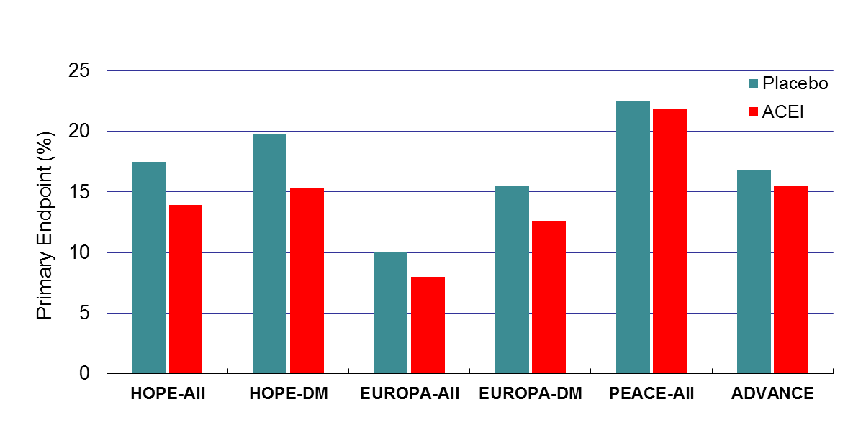
Diabetes Mellitus:
Effect of an ACE Inhibitor
P=0.43
P=0.0004
P<0.001
P=0.04
P=0.13
P=0.0003
N = 9451 3654 13,655 1502 8290 11,140
Use of an ACE inhibitor in most trials of DM is associated with a reduction in adverse CV events
ACE=Angiotensin converting enzyme, CV=Cardiovascular, DM=Diabetes mellitus
Sources:
1. Heart Outcomes Prevention Evaluation Study Investigators. Lancet 2000; 355: 253-259
2. Fox KM et al. Lancet 2003; 362: 782-788
3. Patel A et al. Lancet 2007; 370: 829-840
4. Daly CA et al. Eur Heart J 2005;14:1347-1349
5. The PEACE Trial Investigators. NEJM 2004;351:2058-2068
6. ADVANCE Collaborative Group. NEJM 2008;358:2560-2572
Notes:
Use of an ACE inhibitor in diabetes mellitus results in reduced CV risk.

Slide 51
Diabetes Mellitus:
Lack of Benefit of a Renin Inhibitor
Aliskerin Trial in Type 2 Diabetes Using Cardio-Renal Endpoints (ALTITUDE) Trial
8,561 patients with type 2 DM, as well as, chronic kidney disease and/or CV disease randomized to aliskerin (300 mg/day) or placebo in addition to an ACE inhibitor or angiotensin receptor blocker for a median of 32.9 months*
P=0.12
20
18.3
17.1
Primary end point** (%)
15
0
Placebo
Aliskerin
Addition of a renin inhibitor does not reduce CV risk
*The trial was stopped prematurely
**Composite of CV death or a first occurrence of cardiac arrest with resuscitation, nonfatal myocardial infarction, nonfatal stroke, unplanned hospitalization for heart failure, end-stage renal disease, death attributable to kidney failure, or the need for renal replacement therapy with no dialysis or transplantation available or initiated, or doubling of the baseline serum creatinine level
ACE=Angiotensin converting enzyme, DM=Diabetes mellitus, CV=Cardiovascular
Source: Hans-Henrik P et al. NEJM 2012;367:2204-2213

Slide 52
Diabetes Mellitus:
Effect of Beta Blockade After a MI
Retrospective analysis of 45,308 patients with an acute MI to determine the impact of beta-blocker use on survival based on diabetic status
20
No beta-blocker
Beta-blocker
p<0.001
p<0.001
15
p<0.001
1 Year Mortality (%)
10
5
0
Insulin-treated DM
Non-insulin-treated DM
No DM
Beta-blocker use in DM is associated with a mortality benefit similar to that seen in those without DM
DM=Diabetes mellitus, MI=Myocardial infarction
Source: Chen J et al. JACC 1999;34:1388-1394

Slide 53
Diabetes Mellitus:
Effect of an HMG-CoA Reductase Inhibitor
Heart Protection Study (HPS)
First major vascular event by LDL-C level and prior diabetes status
LDL-C and
diabetes status
Simvastatin
(10,269)
Placebo
(10,267)
Rate ratio (95% CI)
Statin better
Placebo better
<116 mg/dL
With diabetes
191 (15.7%)
252 (20.9%)
No diabetes
407 (18.8%)
504 (22.9%)
≥116 mg/dL
With diabetes
410 (23.3%)
496 (27.9%)
No diabetes
1,025 (20.0%)
1,333 (26.2%)
All patients
2,033 (19.8%)
2,585 (25.2%)
24% reduction
(P<0.0001)
0.4
0.6
0.8
1.0
1.2
1.4
A statin provides CV benefit in diabetics
CV=Cardiovascular
Source: HPS Collaborative Group. Lancet. 2003;361:2005-2016
Notes:
This post-hoc analysis of the Heart Protection Study sought to evaluate the relative effect of simvastatin on the incidence of a first major vascular event based on baseline LDL-C level and diabetic status. There was greater CV risk reduction among diabetic patients with a pretreatment LDL-C level <116 mg/dL (as compared to >116 mg/dL). In a separate substudy of diabetics, lowering the LDL-C level from <116 mg/dL to <77 mg/dL reduced the risk of macrovascular disease risk by about one fourth.

Slide 54
Diabetes Mellitus:
Effect of an HMG-CoA Reductase Inhibitor
Collaborative Atorvastatin Diabetes Study (CARDS)
2,838 patients with type II DM and a baseline LDL-C <160 mg/dL randomized to atorvastatin (10 mg) or placebo for a median of 4 years
15
Placebo
10
Atorvastatin
Cumulative Hazard (%)
5
37% RRR (95% CI: 17-52), P=0.001
0
0
1
2
3
4
4.75
Years
A statin reduces adverse CV events in diabetics
CV=Cardiovascular, DM=Diabetes mellitus, LDL-C=Low density lipoprotein cholesterol
Source: Colhoun HM et al. Lancet 2004;364:685-696
Notes:
The Collaborative Atorvastatin Diabetes Study (CARDS) was designed to evaluate the efficacy of atorvastatin (10 mg/day) in patients with type 2 diabetes mellitus and unremarkable cholesterol levels. The study included 2,838 patients with mean LDL cholesterol levels of 118 mg/dL in the placebo recipients and 119 mg/dL in those assigned to atorvastatin. After a median follow-up of approximately 4 years, atorvastatin was associated with a 37% relative reduction (p =0.001) in the risk of major coronary events.

Slide 55
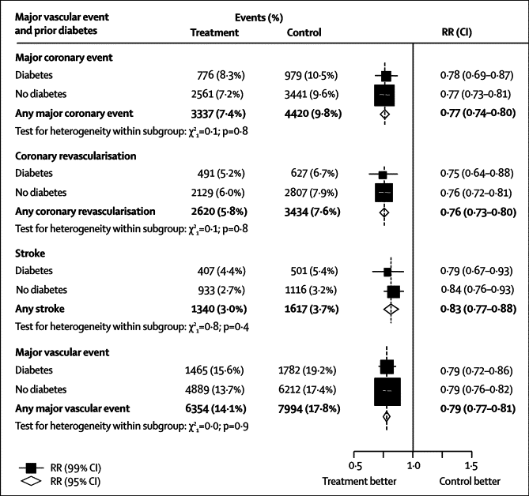
Diabetes Mellitus:
Effect of an HMG-CoA Reductase Inhibitor
Meta-analysis of 18,686 patients with DM randomized to treatment with a HMG-CoA Reductase Inhibitor
A statin reduces adverse CV events in diabetics
CV=Cardiovascular, DM=Diabetes mellitus
Source: Cholesterol Treatment Trialists’ (CTT) Collaborators. Lancet 2008;37:117-125
Notes:
In this meta-analysis of 18,686 diabetic patients, treatment with an HMG-CoA reductase inhibitor resulted in reduced cardiovascular risk.

Slide 56
Diabetes Mellitus:
Effect of a Fibrate
Fenofibrate Intervention and Event Lowering in Diabetes (FIELD)
9,795 diabetic patients randomized to fenofibrate (200 mg) or placebo for 5 years
9
11% RRR
5.9
6
5.2
CHD Death or Nonfatal MI (%)
3
P=0.16
0
Placebo
Fenofibrate
A fibrate does not provide significant additional benefit*
*Unadjusted for concomitant statin use
CHD=Coronary heart disease, MI=Myocardial infarction
Source: Keech A et al. Lancet 2005;366:1849-1861
Notes:
56
The Fenofibrate Intervention and Event Lowering in Diabetes (FIELD) study sought to assess the effect of fibrate therapy on cardiovascular disease events in patients with type 2 diabetes mellitus. A total of 9795 individuals (not on statin therapy at study entry) with diabetes were randomized to fenofibrate (200 mg daily) or placebo for 5 years. The primary outcome was a composite of coronary events, including coronary heart disease death or non-fatal myocardial infarction.
There was no statistically significant reduction in the primary end point with fibrate therapy (5.2% vs. 5.9%, hazard ratio [HR] 0.89, 95% CI 0.75-1.05; p=0.16). Treatment with fenofibrate, however, was associated with less albuminuria progression (p=0.002) and less retinopathy needing laser treatment (5.2% vs 3.6%, p=0.0003).
Some of the disappointing results of the FIELD trial may have been due to a higher than expected use of statins in the placebo group.

Slide 57
Diabetes Mellitus:
Effect of a Fibrate
Action to Control Cardiovascular Risk in Diabetes (ACCORD) Lipid Trial
5,518 diabetic patients on statin therapy randomized to fenofibrate (160 mg) or placebo for 4.7 years
On a background of statin therapy, a fibrate does not reduce CV events
8% RRR
3
2.4
2.2
2
CV death, nonfatal stroke or nonfatal MI (%/year)
1
P=0.32
0
Placebo
Fenofibrate
CV=Cardiovascular, MI=Myocardial infarction, RRR=Relative risk reduction
ACCORD study group. NEJM 2010;362:1563-1574
Notes:
The Action to Control Cardiovascular Risk in Diabetes (ACCORD) Lipid trial sought to assess the effect of fibrate therapy on CV events in patients with type 2 diabetes mellitus already receiving statin therapy. A total of 5,518 diabetic patients were randomized to fenofibrate (160 mg daily) or placebo for 4.7 years. The primary outcome was a composite of coronary events, including CV death, nonfatal stroke, or nonfatal MI. Treatment with fenofibrate was associated with a non-significant 8% relative risk reduction in the primary end point (p=0.32).

Slide 58
Diabetes Mellitus:
Effect of Exercise
Insulin Resistance Atherosclerosis Study (IRAS)
Prospective observational study of 1,467 patients with glucose tolerance ranging between normal and mild non-insulin-dependent DM
2.0
20
min^{-1.}microU^{-1.}mL^{-1.}10⁻⁴
microU/mL
1.0
10
0.0
0
Rare of never
1 per week
Rare of never
2-4 per week
>5 per week
1 per week
2-4 per week
>5 per week
1-3 per month
1-3 per month
Regular exercise improves insulin sensitivity and lowers fasting insulin levels
DM=Diabetes mellitus
Mayer-Davis EJ et al. JAMA 1998;279:669-674
Notes:
The Insulin Resistance Atherosclerosis Study (IRAS) was a prospective observational study of 1,467 patients with variable degrees of glucose tolerance. Regular exercise was noted to improve insulin sensitivity and lower fasting insulin levels.

Slide 59
Diabetes Mellitus:
Effect of Exercise
251 diabetic patients randomized to aerobic training, resistance training, or a combination of both types for 22 weeks
While either aerobic or resistance training improves glycemic control in DM, greater improvement occurs with a combination of the two
Intervention | Δ in HbA1C level (%) | Δ in SBP (mm Hg) | Δ in DBP (mm Hg) | Δ in LDL-C level (mg/dL) | in HDL-C level (mg/dL) | Δ in triglyceride level (mg/dL)
Aerobic training vs. Control | -0.51 p=0.007 | +1.0 p=0.66 | -1.5 p=0.36 | -4.9 p=0.33 | +0.4 p=0.78 | -8.1 p=0.48
Resistance training vs. Control | -0.38 p=0.038 | -0.9 p=0.71 | -1.4 p=0.37 | +0.2 p=0.97 | -0.1 p=0.95 | -18.9 p=0.09
Combined exercise vs. aerobic training | -0.46 p=0.014 | +1.3 p=0.59 | +1.7 p=0.30 | +1.6 p=0.74 | +1.2 p=0.35 | -20.3 p=0.08
Combined exercise vs. resistance training | -0.59 p=0.001 | +3.2 p=0.17 | +1.7 p=0.30 | -3.4 p=0.47 | +1.7 p=0.19 | -9.6 p=0.39
DM=Diabetes mellitus, DBP=Diastolic blood pressure, HbA_{1C}=Glycosylated hemoglobin, HDL-C=High density lipoprotein cholesterol, LDL-C=Low density lipoprotein cholesterol, SBP=Systolic blood pressure
Sigal RJ et al. Ann Intern Med 2007;147:357-369
Notes:
In this small randomized study of 251 diabetic patients, individuals were randomized to aerobic exercise training, resistance exercise training, or a combination of the two for 22 weeks. Both aerobic and resistance exercise training improved glycemic control, with greatest improvement seen in a combination of the two.

Slide 60
Diabetes Mellitus:
Effect of Intensive Risk Factor Modification
STENO-2 Study
160 patients with type 2 DM randomized to targeted intensive multifactorial intervention† or conventional treatment of CV risk factors for 8 years
Intensive risk factor modification reduces CV events in DM
60
Intensive Therapy†
Conventional Therapy
40
Primary Endpoint* (%)
20
HR=0.47, P=0.008
0
12
24
36
48
60
72
84
96
Months of Follow-Up
*Death from CV causes, nonfatal MI, Coronary artery bypass graft surgery, percutaneous coronary intervention, nonfatal stroke, amputation, or surgery for PAD
†Aggressive treatment of dyslipidemia, hyperglycemia, hypertension, microalbuminuria, and secondary prevention of CV disease
CV=Cardiovascular, DM=Diabetes mellitus MI=Myocardial infarction, PAD=Peripheral artery disease
Gaede P et al. NEJM 2003;348:383-393
Notes:
60
The STENO-2 Study randomized 160 patients (mean age of 55 years) with type 2 diabetes and microalbuminuria to targeted intensive multifactorial intervention or conventional treatment of cardiovascular risk factors for 8 years. The targeted intervention involved pharmacologic therapy and behavior modification targeting dyslipidemia, hyperglycemia, hypertension, microalbuminuria, and secondary prevention of cardiovascular disease with aspirin. The primary end point was a composite of nonfatal MI, cardiovascular death, revascularization, nonfatal stroke, and amputation. The hazard ratio for the primary end point in the intensive group was 0.47 (95% CI, 0.22 to 0.74; P=0.01).

Slide 61
Diabetes Mellitus:
Effect of Intensive Risk Factor Modification
Look AHEAD (Action for Health in Diabetes) Study
5145 patients with type 2 DM randomized to an intensive lifestyle intervention (ILI) or conventional diabetes support and education (DSE) for 1 year
Intensive lifestyle intervention in type 2 diabetics improves weight loss, glycemic control, and control of cardiovascular risk factors
Intervention | Δ In weight (%) | Δ In use of DM meds (%) | Δ in fasting glucose (mg/dL) | Δ HbA1C (%) | Δ In use of HTN meds (%) | Δ In use of lipid lowering meds (%) | Δ In metabolic syndrome (%)
ILI vs. DSE | -7.9 p<0.001 | -10.0 p<0.001 | -14.3 p<0.001 | -0.5 p<0.001 | -2.3 p=0.02 | -5.7 p<0.001 | --7.6 p<0.001
*Involving group and individual meetings to achieve and maintain weight loss through decrease caloric intake and increased physical activity
DM=Diabetes mellitus, HbA_{1C}=Glycosylated hemoglobin, HTN=Hypertension
Look AHEAD Research Group. Diabetes Care 2007;30:1374-1383

Slide 62
Diabetes Mellitus:
Impact of Glycemic Control on CV Risk
United Kingdom Prospective Diabetes Study (UKPDS) 35
60
50
5.5%
40
6.5%
HbA_{1C}%
7.5%
30
8.5%
20
9.5%
10.5%
10
0
Myocardial Infarction
Microvascular Disease
The risk of CV disease increases with increasing HbA_{1C}
CV=Cardiovascular, HbA_{1C}=Glycosylated hemoglobin
Stratton IM et al. BMJ 2000;321:405-412
Notes:
There is an increase in the risk of both macrovascular and microvascular complications as hemoglobin A1C levels rise.

Slide 63
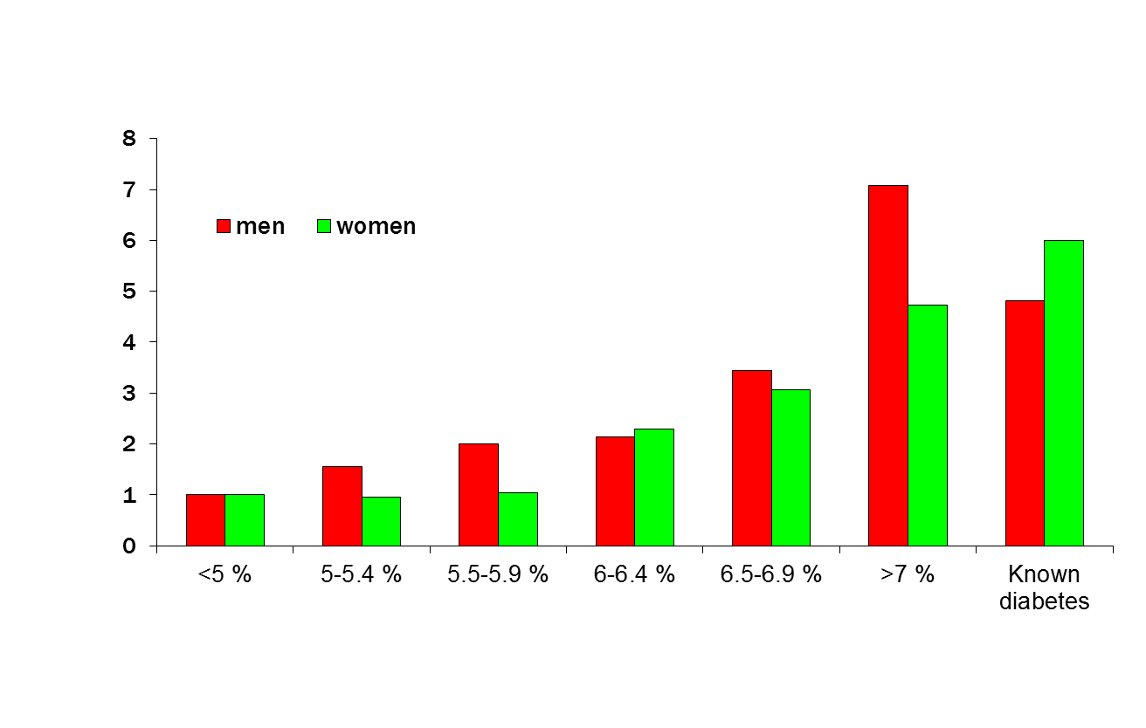
Diabetes Mellitus:
Impact of Glycemic Control on CV Risk
Prospective observational study of 10,232 patients with DM aged 45-79 years
Adjusted Relative Risk of Coronary Artery Disease
The risk of CV disease increases with increasing HbA_{1C}
CV=Cardiovascular, DM=Diabetes mellitus, HbA_{1C}=Glycosylated hemoglobin
Khaw KT et al. Ann Intern Med 2004;141:413-420
Notes:
The European Prospective Investigation into Cancer in Norfolk (EPIC-Norfolk) study prospectively evaluated 25,623 individuals between 40 and 79 years old living in Norfolk, United Kingdom. A total of 10,232 patients who had available hemoglobin A1C measurements were followed for an average of 6 years. There was a noted increase in the risk of CV disease with increasing levels of hemoglobin A1C.

Slide 64
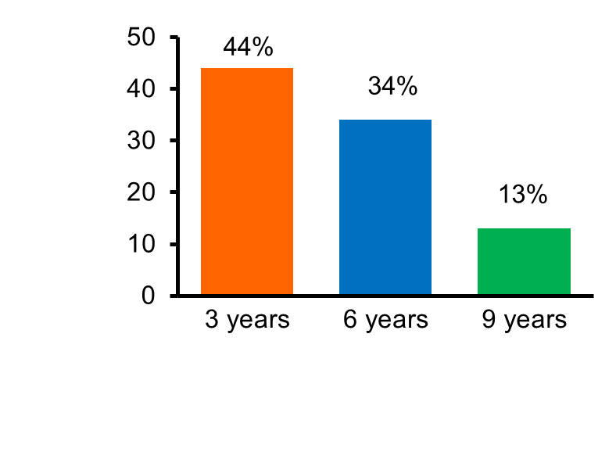
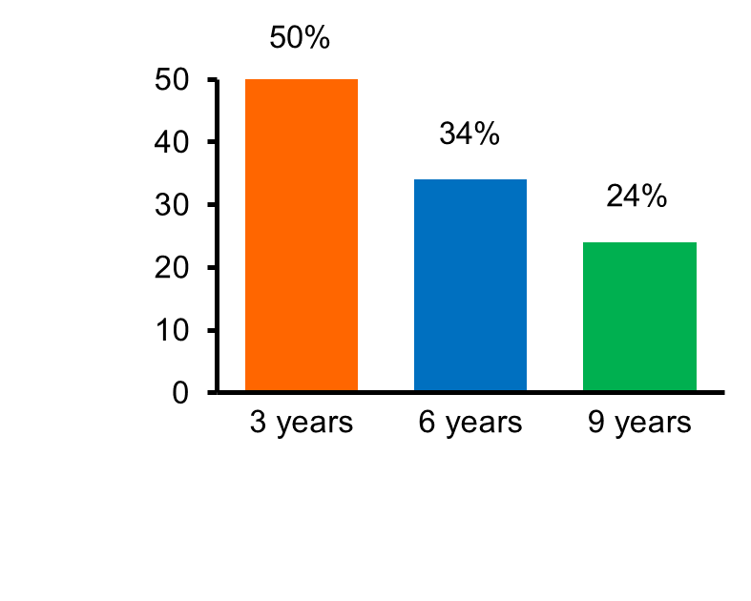
Diabetes Mellitus:
Change in Glycemic Control Over Time
United Kingdom Prospective Diabetes Study (UKPDS) 49
4,075 patients with DM randomized to diet alone, insulin, sulfonylurea, or metformin for 9 years
Glycemic control in patients on DM monotherapy worsens over time
% with A1C <7% (%)
% with A1C <7% (%)
Adequately controlled and treated with metformin*
Adequately controlled and treated with sulfonylureas†
*Overweight drug-naïve patients
†Normal weight and overweight drug-naïve patients
DM=Diabetes mellitus, HbA_{1C}=Glycosylated hemoglobin
Source: Turner RC et al. JAMA 1999;281:2005-2012
Notes:
In the United Kingdom Prospective Diabetes Study (UKPDS), 4,075 patients with diabetes mellitus were randomized to diet alone, insulin, a sulfonylurea, or metformin for 9 years. Only about 50% of patients were able to maintain a hemoglobin A1C level <7% with monotherapy at 3 years, with this number dropping to <25% by 9 years. Most diabetics need multiple agents to achieve adequate long-term glycemic control.

Slide 65
Diabetes Mellitus (Type I):
Effect of Intensive Glycemic Control
Diabetes Control and Complications Trial (DCCT)
1,441 patients with DM randomized to intensive (mean HbA_{1C} 7%) or conventional (mean HbA_{1C} 9%) insulin therapy
Intensive glycemic control in diabetic patients reduces the risk of microvascular complications
Relative risk
Mean A1C
DM=Diabetes mellitus, HbA_{1C}=Glycosylated hemoglobin
The Diabetes Control and Complications Trial Research Group. NEJM 1993;329:977-986
Notes:
The Diabetes Control and Complications Trial (DCCT) demonstrated that intensive glycemic control in type 1 diabetics leads to reduced microvascular complications.

Slide 66
Diabetes Mellitus (Type I):
Effect of Intensive Glycemic Control
Diabetes Control and Complications Trial (DCCT) and Epidemiology of Diabetes Interventions and Complications (EDIC)
12%
10%
8%
6%
Conventional
Intensive
0.12
0.10
0.08
0.06
0.04
0.02
0.00
42% risk reduction
P =0.02
Conventional
Hemoglobin A_{1C}
Cumulative incidence of any cardiovascular outcome
Intensive
P < 0.001
P < 0.001
P = 0.61
DCCT
End of
Randomized Treatment
EDIC
Year 1
EDIC
Year 7
0
2
4
6
8
10
12
14
16
18
20
Years Since Entry*
Intensive glycemic control in DM reduces long-term CV risk
Sources:
DCCT/EDIC Research Group. JAMA 2002;287:2563-2569
DCCT/EDIC Research Group. NEJM 2005;353:2643-2653
Notes:
The DCCT and Epidemiology of Diabetes Interventions and Complications (EDIC) studies demonstrated that intensive glycemic control in diabetics improves long-term cardiovascular risk.

Slide 67
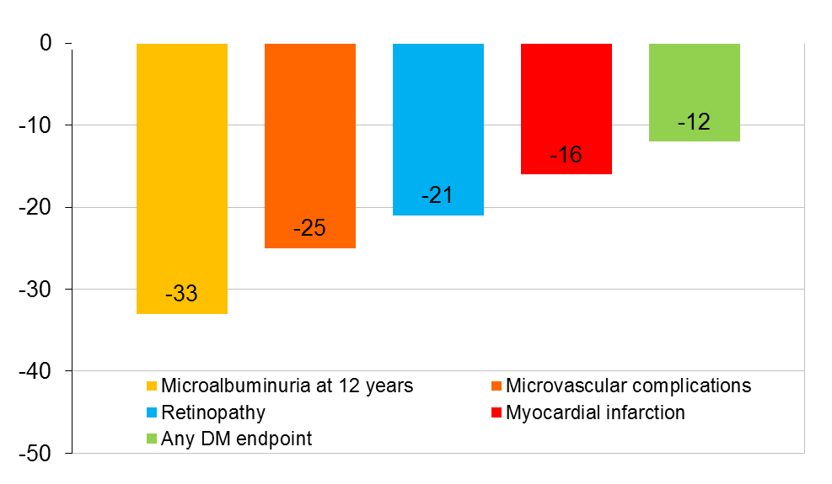
Diabetes Mellitus (Type II):
Effect of Intensive Glycemic Control
United Kingdom Prospective Diabetes Study (UKPDS)
3,867 patients with DM randomized to intensive therapy with a sulphonylurea or insulin (mean HbA_{1C} 7.0%) or conventional therapy (mean HbA_{1C} 7.9%)
P=0.03
P=0.05
% relative risk reduction
P=0.02
P<0.01
P<0.01
Intensive glycemic control in DM reduces the risk of
microvascular complications
DM=Diabetes mellitus, HbA_{1C}=Glycosylated hemoglobin
Source: UKPDS Group. Lancet 1998;352:837-853
Notes:
67
The UK Prospective Diabetes Study (UKPDS) Group randomized 3,867 newly diagnosed patients with type 2 diabetes to intensive treatment with a sulphonylurea or insulin vs. conventional treatment with dietary modification. Over 10 years of follow-up, the hemoglobin A1c was 7.0% (6.2-8.2%) in the intensive group compared with 7.9% (6.9-8.8%) in the conventional group. In the intensive treatment group, the relative risk was 6% lower (non-significant) for all-cause mortality (p=0.44), 12% lower for any diabetes-related endpoint (p=0.029), and 25% lower for microvascular endpoints (p=0.0099).

Slide 68
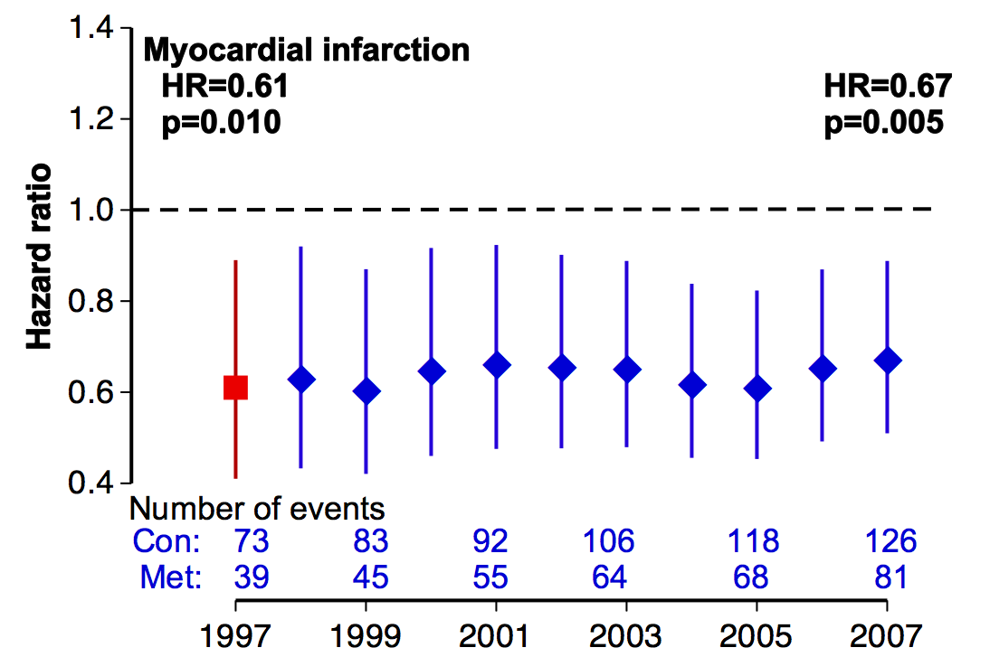
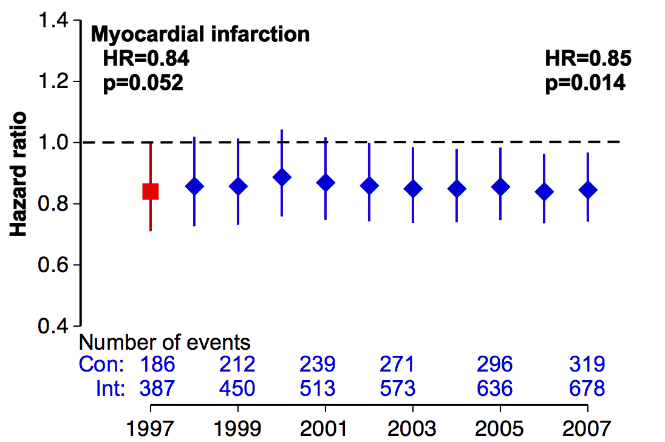
Diabetes Mellitus (Type II):
Effect of Intensive Glycemic Control
United Kingdom Prospective Diabetes Study (UKPDS)
10-Year Follow-Up
Sulphonylurea vs. Conventional Therapy
Insulin vs. Conventional Therapy
Intensive glycemic control in DM reduces the long-term risk of MI
DM=Diabetes mellitus, MI=Myocardial infarction
Source: Holman RR et al. NEJM 2008;359:1577-1589
Notes:
In a 10-year follow-up of the United Kingdom Prospective Diabetes Study (UKPDS), long-term risk of a myocardial infarction was reduced with intensive glycemic control in diabetic patients.

Slide 69
Diabetes Mellitus (Type II):
Effect of Intensive Glycemic Control
Action to Control Cardiovascular Risk in Diabetes (ACCORD) Trial
10,251 diabetic patients randomized to intensive glucose lowering (HbA_{1C} <6%) or standard glucose lowering (HbA_{1C} 7.0-7.9%) for 3.5 years
Intensive glucose lowering does not reduce adverse CV events and
increases all-cause mortality
P=0.16
9
9
P=0.04
7.2
6.9
6
6
5.0
CV death, MI, or stroke (%)
All-cause mortality (%)
4.0
3
3
0
0
Standard Therapy
Intensive Glucose Lowering
Standard Therapy
Intensive Glucose Lowering
CV=Cardiovascular, HbA_{1C}=Glycosylated hemoglobin, MI=Myocardial infarction
Source: ACCORD Study Group. NEJM 2008;358;2545-2559
Notes:
The Action to Control Cardiovascular Risk in Diabetes (ACCORD) trial sought to evaluate whether intensive glucose lowering with a target HbA1C <6.0% would reduce the rate of cardiovascular events as compared to standard glucose lowering with a target HbA1C of 7.0-7.9% in 10,251 diabetic patients. The trial was stopped early after a mean of 3.5 years due to increased mortality in the intensive glucose lowering group (p=0.04). Cardiovascular event rates were similar in the intensive glucose lowering and standard therapy groups (p=0.16).

Slide 70
Diabetes Mellitus (Type II):
Effect of Intensive Glycemic Control
Action in Diabetes and Vascular Disease (ADVANCE) Trial
11,140 diabetic patients randomized to intensive glucose lowering (mean HbA_{1C} of 6.5%) or standard glucose lowering (mean HbA_{1C} of 7.3%) for 5 years
Intensive glucose lowering reduces adverse CV events, largely through a significant reduction in microvascular events
30
P=0.01
15
P=0.28
20.0
9.6
20
18.1
10
8.9
Macrovascular and microvascular events (%)
All-cause mortality (%)
10
5
0
0
Standard Therapy
Intensive Glucose Lowering
Standard Therapy
Intensive Glucose Lowering
CV=Cardiovascular, HbA_{1C}=Glycosylated hemoglobin
Source: ADVANCE Collaborative Group. NEJM 2008;358:2560-2572
Notes:
The Action in Diabetes and Vascular Disease (ADVANCE) trial randomized 11,140 diabetic patients to intensive glucose lowering (mean HbA1C of 6.5%) or standard glucose lowering (mean HbA1C or 7.3%) for a median of 5 years. The risk of microvascular or macrovascular events was reduced in the intensive glucose lowering group (p=0.01), mainly as a result of a 21% relative risk reduction in nephropathy. All-cause mortality was similar in the intensive glucose lowering and standard therapy groups (p=0.28).

Slide 71
Diabetes Mellitus (Type II):
Effect of Intensive Glycemic Control
Veterans Affairs Diabetes Trial (VADT)
1,791 diabetic patients randomized to intensive glucose lowering (mean HbA_{1C} of 6.9%) or standard glucose lowering (mean HbA_{1C} of 8.4%) for 7.5 years
Intensive glucose lowering is not superior in reducing CV events or mortality
P=0.14
P=0.62
45
15
33.5
10.6
11.4
29.5
30
10
Any CV event* (%)
All-cause mortality (%)
15
5
0
0
Standard Therapy
Intensive Glucose Lowering
Standard Therapy
Intensive Glucose Lowering
*Composite of MI, stroke, CV death, CHF, surgery for vascular disease, CAD, and amputation for gangrene
CAD=Coronary artery disease, CV=Cardiovascular, HbA_{1C}=Glycosylated hemoglobin, MI=Myocardial infarction
Source: Duckworth W et al. NEJM 2009;360;129-139
Notes:
The Veterans Affairs Diabetes Trial (VADT) randomized 1,791 diabetic patients to intensive glucose lowering (mean HbA1C of 6.9%) or standard glucose lowering (mean HbA1C of 8.4%) for 7.5 years. Cardiovascular events and all-cause mortality were not significantly different in the intensive glucose lowering group as compared to the standard therapy group (p=0.14 and p=0.62, respectively).

Slide 72
Evidence for Current Cardiovascular Disease
Prevention Guidelines
Diagnosis Criteria and Guideline Recommendations

Slide 73
ADA Categories of Increased
Risk for Diabetes Mellitus
Impaired fasting glucose (IFG): Defined as a fasting plasma glucose (FPG) of 100-125 mg/dL (5.6-6.9 mmol/L)*
Impaired glucose tolerance (IGT): Defined as a 2 hour plasma glucose on a 75 gram oral glucose tolerance test (OGTT) of 140-199 mg/dL (7.8-11.0 mmol/L)*
A_{1C}: 5.7-6.4%*
*For all three tests, risk is continuous, extending below the lower limit of the range and becoming disproportionately greater at higher ends of the range
A_{1C}=Glycosylated hemoglobin, ADA=American Diabetes Association,
IFG=Impaired fasting glucose, IGT=Impaired glucose
tolerance, OGTT=Oral glucose tolerance test
Source: American Diabetes Association. Diabetes Care 2010;33:S11-61

Slide 74
ADA Criteria for the Diagnosis
of Diabetes Mellitus
A_{1C} >6.5%. The test should be performed in a laboratory using a method that is certified and standardized to the DCCT assay*.
FPG >126 mg/dL (7.0 mmol/L). Fasting is defined as no caloric intake for at least 8 hours*.
Two-hour plasma glucose >200 mg/dL (11.1 mmol/L) during an OGTT. The test should use a glucose load equivalent to 75 grams of anhydrous glucose dissolved in water*.
Random plasma glucose >200 mg/dL (11.1 mmol/L) in patients with classic symptoms of hyperglycemia or a hyperglyemic crisis.
OR
OR
OR
*In the absence of unequivocal hyperglycemia, the first 3 criteria should be confirmed by repeat testing
A_{1C}=Glycosylated hemoglobin, ADA=American Diabetes Association,
DCCT=Diabetes Control and Complications, FPG=Fasting
plasma glucose, OGTT=Oral glucose tolerance test
Source: American Diabetes Association. Diabetes Care 2010;33:S11-61

Slide 75
ADA Criteria for Testing for Diabetes Mellitus
in Asymptomatic Adult Individuals
Primary Prevention
All overweight adults (BMI >25 kg/m²) with another risk factor:
    Physical inactivity
    First-degree relative with DM
    Member of high-risk ethnic population (e.g., African American, Latino, Native American, Asian American, Pacific Islander)
    Women who delivered a baby >9 lbs or were diagnosed with gestational DM
    Hypertension (BP >140/90 mm Hg or on therapy for hypertension)
    HDL-C level <35 mg/dL (0.9 mmol/L) and/or a triglyceride level >250 mg/dL (2.82 mmol/L)
ADA=American Diabetes Association, BMI=Body mass index, BP=Blood
pressure, DM=Diabetes mellitus, HDL-C=High density lipoprotein cholesterol
Source: American Diabetes Association. Diabetes Care 2010;33:S11-61

Slide 76
ADA Criteria for Testing for Diabetes Mellitus
in Asymptomatic Adult Individuals (Continued)
Primary Prevention
All overweight adults (BMI >25 kg/m²) with another risk factor:
  Women with polycystic ovary syndrome
  A_{1C} >5.7%, IGT, or IFG on previous testing
  Other clinical conditions associated with insulin resistance (e.g. severe obesity, acanthosis nigricans)
  History of cardiovascular disease
In the absence of the above criteria, testing should begin at age 45 years
If the test results are normal, testing should be repeated at 3-year intervals, with consideration of more frequent testing based on initial test results and risk status
A_{1C}=Glycosylated hemoglobin, ADA=American Diabetes Association, BMI=Body
mass index, IFG=Impaired fasting glucose, IGT=Impaired glucose tolerance
Source: American Diabetes Association. Diabetes Care 2010;33:S11-61

Slide 77
ADA Recommendations to Prevent or
Delay the Onset of Type II Diabetes Mellitus
Primary Prevention
Patients with an A_{1C} 5.7-6.4%, IGT, or IFG should be referred to an effective ongoing support program for weight loss of 5-10% of body weight and an increase in physical activity of at least 150 minutes/week of moderate activity such as walking.
Follow-up counseling appears to be important for success.
In addition to lifestyle counseling, metformin may be considered in those that are at very high risk for developing diabetes mellitus* and who are obese and <60 years of age
Monitoring for the development of diabetes mellitus in those with pre-diabetes should be performed every year.
*Combined IFG and IGT plus other risk factors, such as A_{1C} >6%, hypertension, low HDL-C,
elevated triglycerides, or family history of diabetes mellitus in a first-degree relative
A_{1C}=Glycosylated hemoglobin, ADA=American Diabetes Association, HDL-C=High density
lipoprotein cholesterol, IFG=Impaired fasting glucose, IGT=Impaired glucose tolerance
Source: American Diabetes Association. Diabetes Care 2010;33:S11-61

Slide 78
AHA/ACCF Diabetes Mellitus
Recommendations
Secondary Prevention
I
IIa
IIb
III
Care for diabetes should be coordinated with the patient’s primary care physician and/or endocrinologist.
Lifestyle modifications including daily physical activity, weight management, blood pressure control, and lipid management are recommended for all patients with diabetes
Metformin is an effective first-line pharmacotherapy and can be useful if not contraindicated
C
I
IIa
IIb
III
B
I
IIa
IIb
III
A
Source: Smith SC Jr. et al. JACC 2011;58:2432-2446

Slide 79
AHA/ACCF Diabetes Mellitus
Recommendations (Continued)
Secondary Prevention
I
IIa
IIb
III
It is reasonable to individualize the intensity of blood sugar–lowering interventions based on the individual patient’s risk of hypoglycemia during treatment.
Initiation of pharmacotherapy interventions to achieve target HbA1c may be reasonable
A target HbA1c of <7% may be considered
C
I
IIa
IIb
III
A
I
IIa
IIb
III
C
Source: Smith SC Jr. et al. JACC 2011;58:2432-2446

Slide 80
AHA/ACCF Diabetes Mellitus
Recommendations (Continued)
Secondary Prevention
Less stringent HbA1c goals may be considered for patients with a history of severe hypoglycemia, limited life
expectancy, advanced microvascular or macrovascular complications, or extensive comorbidities, or those in whom the goal is difficult to attain despite intensive therapeutic interventions.
I
IIa
IIb
III
C
Source: Smith SC Jr. et al. JACC 2011;58:2432-2446

Slide 81
ADA/AHA/ACCF Primary Prevention of CV Disease
Antiplatelet Agent Recommendations
Primary Prevention
Low-dose aspirin therapy (75-162 mg/day) is reasonable for adults with DM and no previous history of vascular disease who are at increased CVD risk (10-year risk >10%) and who are not at increased risk for bleeding (based on a history of previous GI bleeding or peptic ulcer disease or concurrent use of other medications that increase bleeding risk such as NSAIDs or warfarin). Those adults with DM at increased CVD risk include most men >50 years of age or women >60 years of age who have at least one additional major risk factor.*†
I
IIa
IIb
III
B
*ADA Level C
†Includes those with family history of premature CVD, hypertension, smoking, dyslipidemia, or albuminuria
ACCF=American College of Cardiology Foundation, ADA=American Diabetes Association, AHA=American Heart Association, CV=Cardiovascular, CVD=Cardiovascular disease, DM=Diabetes mellitus, GI=Gastrointestinal, NSAIDs=Non-steroidal anti-inflammatory drugs
Source: Pignone M et al. Circulation 2010;121:2694-2701

Slide 82
ADA/AHA/ACCF Primary Prevention of CV Disease
Antiplatelet Agent Recommendations (Continued)
Primary Prevention
Aspirin should not be recommended for CV prevention for adults with DM at low CVD risk (men <50 years of age and women <60 years of age with no major additional CVD risk factors* [10-year risk <5%], as the potential adverse effects from bleeding offset the potential benefits.†
Low-dose aspirin (75-162 mg/day) may be considered for those with DM at intermediate CVD risk (younger patients with >1 risk factors* or older patients with no risk factors*, or patients with a 10-year risk of 5-10% until further research is available.‡
I
IIa
IIb
III
C
I
IIa
IIb
III
C
*Includes those with family history of premature CVD,
hypertension, smoking, dyslipidemia, or albuminuria
†ADA Level C, ‡ADA Level E
ACCF=American College of Cardiology Foundation, ADA=American Diabetes Association, AHA=American Heart Association, CV=Cardiovascular, CVD=Cardiovascular disease, DM=Diabetes mellitus
Source: Pignone M et al. Circulation 2010;121:2694-2701

Slide 83
AHA Primary Prevention of CV Disease in DM
Blood Pressure Recommendations
Primary Prevention
BP should be measured at every routine visit. Patients with a SBP >130 mm Hg or DBP >80 mm Hg should have BP confirmed on a separate day.
Patients should be treated to a SBP <130 mm Hg and a DBP <80 mm Hg.
Patients with a SBP of 130-139 mm Hg or a DBP of 80-89 mm Hg should initiate lifestyle modification* alone for a maximum of 3 months. If, after these efforts, targets are not achieved, treatment with pharmacological agents should be initiated.
*Includes weight control, increased physical activity, alcohol moderation, sodium reduction, and emphasis on increased consumption of fresh fruits, vegetables, and low-fat dairy products
AHA=American Heart Association, BP=Blood pressure, CV=Cardiovascular, DBP=Diastolic blood pressure, DM=Diabetes mellitus, SBP=Systolic blood pressure
Source: Buse JB et al. Circulation 2007;115:114-126

Slide 84
AHA Primary Prevention of CV Disease in DM
Blood Pressure Recommendations (Continued)
Primary Prevention
Patients with a SBP >140 mm Hg or DBP >90 mm Hg should receive drug therapy in addition to lifestyle and behavioral therapy.
All patients with hypertension should be treated with a regimen that includes an ACE inhibitor or an ARB. If one class is not tolerated, the other should be substituted. Other drug classes* that have been demonstrated to reduce CVD events should be added as needed to achieve BP targets.
If ACE inhibitors, ARBs, or diuretics are used, renal function and serum potassium levels should be monitored within the first 3 months. If stable, follow-up could occur every 6 months.
*Includes beta-blockers, thiazide diuretics, and calcium channel blockers
ACE=Angiotensin converting enzyme, ARB=Angiotensin receptor blocker,
BP=Blood pressure, CV=Cardiovascular, CVD=Cardiovascular disease, DBP=Diastolic blood pressure, DM=Diabetes mellitus, SBP=Systolic blood pressure
Source: Buse JB et al. Circulation 2007;115:114-126

Slide 85
AHA Primary Prevention of CV Disease in DM
Blood Pressure Recommendations (Continued)
Primary Prevention
Multiple-drug therapy is generally required to achieve BP targets.
In elderly hypertensive patients, BP should be lowered gradually to avoid complications.
Orthostatic measurement of BP should be performed when clinically indicated.
Patients not achieving target BP despite multiple-drug therapy should be referred to a physician specializing in the care of patients with hypertension.
AHA=American Heart Association, BP=Blood pressure, CV=Cardiovascular, DM=Diabetes Mellitus
Source: Buse JB et al. Circulation 2007;115:114-126

Slide 86
ADA Blood Pressure Recommendations
for Patients with Diabetes Mellitus
Primary Prevention
BP should be measured at every routine DM visit. Patients found to have a SBP >130 mm Hg or a DBP >80 mm Hg should have BP confirmed on a separate day. A repeat SBP >130 mm Hg or a repeat DBP >80 mm Hg confirms a diagnosis of hypertension.
Patients with DM should be treated to a SBP <130 mm Hg.
Patients with DM should be treated to a DBP <80 mm Hg.
Patients with a SBP 130-139 mm Hg or a DBP 80-89 mm Hg may be given lifestyle therapy alone for a maximum of 3 months, and then if targets are not achieved, patients should have pharmacologic agents added.
ADA=American Diabetes Association, BP=Blood pressure, DBP=Diastolic blood pressure, DM=Diabetes mellitus, SBP=Systolic blood pressure
Source: American Diabetes Association. Diabetes Care 2010;33:S11-61

Slide 87
ADA Blood Pressure Recommendations
for Patients with Diabetes Mellitus (Continued)
Primary Prevention
Patients with more severe hypertension (SBP >140 mm Hg or DBP >90 mm Hg) at diagnosis or follow-up should receive pharmacologic therapy in addition to lifestyle therapy.
Lifestyle therapy for hypertension consists of weight loss if overweight, DASH-style dietary pattern including reducing sodium and increasing potassium intake, moderation of alcohol intake, and increased physical activity.
ACE=Angiotensin converting enzyme, ADA=American Diabetes Association, BP=Blood pressure, DBP=Diastolic blood pressure, DM=Diabetes mellitus, GFR=Glomerular filtration rate, SBP=Systolic blood pressure
Source: American Diabetes Association. Diabetes Care 2010;33:S11-61

Slide 88
ADA Blood Pressure Recommendations
for Patients with Diabetes Mellitus (Continued)
Primary Prevention
Pharmacologic therapy for patients with DM and hypertension should be paired with a regimen that includes either an ACE inhibitor or an ARB. If one class is not tolerated, the other should be substituted. If needed to achieve BP targets, a thiazide diuretic should be added to those with an estimated GFR >30 ml/min and a loop diuretic with an estimated GFR <30 ml/min.
Multiple drug therapy (two or more agents at maximal doses) is generally required to achieve BP targets.
ACE=Angiotensin converting enzyme, ADA=American Diabetes Association, ARB=Angiotensin receptor blocker, BP=Blood pressure, DM=Diabetes mellitus, GFR=Glomerular filtrate rate
Source: American Diabetes Association. Diabetes Care 2010;33:S11-61

Slide 89
ADA Blood Pressure Recommendations
for Patients with Diabetes Mellitus (Continued)
Primary Prevention
If an ACE inhibitor, ARB, or diuretic is used, kidney function and serum potassium levels should be closely monitored.
In pregnant patients with DM and chronic hypertension, BP target goals of 110-129/65-79 mm Hg are suggested in the interest of long-term maternal health and minimizing impaired fetal growth.
An ACE inhibitor and ARB are contraindicated during pregnancy.
ACE=Angiotensin converting enzyme, ADA=American Diabetes Association, ARB=Angiotensin receptor blocker, BP=Blood pressure, DM=Diabetes mellitus
Source: American Diabetes Association. Diabetes Care 2010;33:S11-61

Slide 90
AHA Primary Prevention of CV Disease in DM
Cholesterol Recommendations
Primary Prevention
In adult patients, lipid levels should be measured at least annually and more often if needed to achieve goals. In adults <40 years of age with low-risk lipid values (LDL-C <100 mg/dL, HDL-C >50 mg/dL, and triglycerides <150 mg/dL), lipid assessments may be repeated every 2 years.
Lifestyle modification deserves primary emphasis for all individuals. Patients should focus on the reduction of saturated fat and cholesterol intake, weight loss (if indicated), and increases in dietary fiber and physical activity. These lifestyle changes have been shown to improve the lipid profile.
AHA=American Heart Association, CV=Cardiovascular, DM=Diabetes mellitus, HDL-C=High density lipoprotein cholesterol, LDL-C=Low density lipoprotein cholesterol
Source: Buse JB et al. Circulation 2007;115:114-126

Slide 91
AHA Primary Prevention of CV Disease in DM
Cholesterol Recommendations (Continued)
Primary Prevention
In those >40 years of age without overt CVD, but with >1 major CVD risk factor*, the primary goal is an LDL-C level <100 mg/dL. If LDL-C lowering drugs are used, a reduction of at least 30-40% in LDL-C levels should be obtained. If the baseline LDL-C level is <100 mg/dL, statin therapy should be initiated based on risk factor assessment and clinical judgment.
In those <40 years of age without overt CVD, but at increased risk of CVD either by clinical judgment or by risk calculator, the LDL-C goal is <100 mg/dL, and LDL-C lowering drugs should be considered if lifestyle changes do not achieve the goal.
*Includes cigarette smoking, hypertension [BP >140/90 mm Hg or use of antihypertensive medication], low HDL-C cholesterol [<40 mg/dL], and family history of premature CHD [CHD in male first-degree relative <55 years of age; CHD in female first-degree relative <65 years of age].
AHA=American Heart Association, CV=Cardiovascular, CVD=Cardiovascular disease, DM=Diabetes mellitus, HDL-C=High density lipoprotein cholesterol, LDL-C=Low density lipoprotein cholesterol
Source: Buse JB et al. Circulation 2007;115:114-126

Slide 92
AHA and ADA Primary Prevention of CV Disease
in DM Cholesterol Recommendations
Primary Prevention
The ADA and AHA suggest different approaches to the management of HDL-C and triglyceride-associated CVD risk.
  The AHA suggests that in patients with triglyceride levels of 200-499 mg/dL, a non-HDL-C goal of <130 mg/dL is a secondary target. If triglycerides are >500 mg/dL, therapeutic options include a fibrate or niacin before LDL-C lowering therapy and treatment of LDL-C to goal after triglyceride-lowering therapy. A non HDL-C level <130 mg/dL should be achieved if possible
  The ADA suggests lowering triglycerides to <150 mg/dL and raising HDL-C to >40 mg/dL. In women an HDL-C goal 10 mg/dL higher (>50 mg/dL) should be considered.
ADA=American Diabetes Association, AHA=American Heart Association, CV=Cardiovascular, CVD=Cardiovascular disease, DM=Diabetes mellitus, HDL-C=High density lipoprotein cholesterol, LDL-C=Low density lipoprotein cholesterol
Sources:
Buse JB et al. Circulation 2007;115:114-126
American Diabetes Association. Diabetes Care 2010;33:S11-61

Slide 93
ADA Cholesterol Recommendations for
Patients with Diabetes Mellitus
Primary Prevention
In most adult patients, a fasting lipid profile should be measured at least annually. In adults with low-risk lipid values (LDL-C <100 mg/dL, HDL-C >50 mg/dL, and triglycerides <150 mg/dL), lipid assessments may be repeated every 2 years.
Lifestyle modification focusing on the reduction of saturated fat, trans fat, and cholesterol intake; increase of omega-3 fatty acids, viscous fiber, and plant stanols/sterols; weight loss (if indicated); and increased physical activity should be recommended to improve the lipid profile in patients with DM.
ADA=American Diabetes Association, DM=Diabetes mellitus, HDL-C=High density lipoprotein cholesterol, LDL-C=Low density lipoprotein cholesterol
Source: American Diabetes Association. Diabetes Care 2010;33:S11-61

Slide 94
ADA Cholesterol Recommendations for
Patients with Diabetes Mellitus (Continued)
Primary and Secondary Prevention
Statin therapy should be added to lifestyle therapy, regardless of baseline lipid levels for diabetic patients:
  With overt CV disease
  Without CV disease who are over the age of 40 years and have >1 other CV disease risk factors
For patients at lower risk (without overt CV disease and <40 years of age), statin therapy should be considered in addition to lifestyle therapy if LDL-C remains >100 mg/dL or in those with multiple CV disease risk factors.
ADA=American Diabetes Association, CV=Cardiovascular, LDL-C=Low density lipoprotein cholesterol
Source: American Diabetes Association. Diabetes Care 2010;33:S11-61

Slide 95
ADA Cholesterol Recommendations for
Patients with Diabetes Mellitus (Continued)
Primary and Secondary Prevention
In individuals without overt CV disease, the primary goal is an LDL-C <100 mg/dL (2.6 mmol/L).
In individuals with overt CV disease, a lower LDL-C goal of <70 mg/dL (1.8 mmol/L), using a high dose of statin is an option.
If drug-treated patients do not reach the above targets on maximal tolerated statin therapy, a reduction in LDL-C of approximately 30-40% from baseline is an alternative therapeutic goal.
Triglyceride levels <150 mg/dL (1.7 mmol/L) and HDL-C >40 mg/dL (1.0 mmol/L) in men and >50 mg/dL (1.3 mmol/L) in women, are desirable. However, LDL-C targeted statin therapy remains the preferred strategy.
ADA=American Diabetes Association, CV=Cardiovascular, HDL-C=High density lipoprotein cholesterol, LDL-C=Low density lipoprotein cholesterol
Source: American Diabetes Association. Diabetes Care 2010;33:S11-61

Slide 96
ADA Cholesterol Recommendations for
Patients with Diabetes Mellitus (Continued)
Primary Prevention
Triglyceride levels <150 mg/dL (1.7 mmol/L) and HDL-C >40 mg/dL (1.0 mmol/L) in men and >50 mg/dL (1.3 mmol/L) in women, are desirable. However, LDL-C targeted statin therapy remains the preferred strategy.
If targets are not reached on maximally tolerated doses of statins, combination therapy using statins and other lipid-lowering agents may be considered to achieve lipid targets but has not been evaluated in outcome studies for either CV disease outcomes or safety.
Statin therapy is contraindicated in pregnancy.
ADA=American Diabetes Association, CV=Cardiovascular, HDL-C=High density lipoprotein cholesterol, LDL-C=Low density lipoprotein cholesterol
Source: American Diabetes Association. Diabetes Care 2010;33:S11-61

Slide 97
AHA Primary Prevention of CV Disease in DM
Tobacco Recommendations
Primary Prevention
All patients should be asked about tobacco use status at every visit.
Every tobacco user should be advised to quit.
The tobacco user’s willingness to quit should be assessed.
The patient can be assisted by counseling and by developing a plan to quit.
Follow-up, referral to special programs, or pharmacotherapy (e.g., NRT and buproprion) should be incorporated as needed.
AHA=American Heart Association, CV=Cardiovascular,
DM=Diabetes mellitus, NRT=Nicotine replacement therapy
Source: Buse JB et al. Circulation 2007;115:114-126

Slide 98
ADA Smoking Cessation Recommendations
for Patients with Diabetes Mellitus
Primary Prevention
All patients should be advised not to smoke.
Smoking cessation counseling and other forms of treatment should be included as a routine component of diabetes care.
ADA=American Diabetes Association
Source: American Diabetes Association. Diabetes Care 2010;33:S11-61

Slide 99
AHA Primary Prevention of CV Disease in DM
Weight Management Recommendations
Primary Prevention
Structured programs that emphasize lifestyle changes such as reduced fat (<30% of daily energy) and total energy intake and increased regular physical activity, alone with regular participant contact, can produce long-term weight loss on the order of 5-7% of starting weight, with improvement in blood pressure.
For individuals with elevated plasma triglycerides and reduced HDL-C, improved glycemic control, moderate weight loss (5-7% of starting weight), increased physical activity, dietary saturated fat restriction, and modest replacement of dietary carbohydrates (5-7%) by either monounsaturated or polyunsaturated fats may be beneficial.
AHA=American Heart Association, CV=Cardiovascular, DM=Diabetes mellitus, HDL-C=High density lipoprotein cholesterol
Source: Buse JB et al. Circulation 2007;115:114-126

Slide 100
AHA Primary Prevention of CV Disease in DM
Dietary Recommendations
Primary Prevention
To achieve reductions in LDL-C levels:
  Saturated fats should be <7% of energy intake.
  Dietary cholesterol intake should be <200 mg/day.
  Intake of trans-unsaturated fatty acids should be <1% of energy intake.
Total energy intake should be adjusted to achieve body-weight goals.
Total dietary fat intake should be moderated (25-35% of total calories) and should consist mainly of monounsaturated or polyunsaturated fat.
AHA=American Heart Association, CV=Cardiovascular, DM=Diabetes mellitus, LDL-C=Low density lipoprotein cholesterol
Source: Buse JB et al. Circulation 2007;115:114-126

Slide 101
AHA Primary Prevention of CV Disease in DM
Dietary Recommendations
Primary Prevention
Ample intake of dietary fiber (>14 grams/1000 calories consumed) may be of benefit.
If individuals choose to drink alcohol, daily intake should be limited to 1 drink* for adult women and 2 drinks* for adult men. Alcohol ingestion increase caloric intake and should be minimized when weight loss is the goal. Individuals with elevated plasma triglyceride levels should limit alcohol intake, because intake may exacerbate hypertriglyceridemia.
In both normotensive and hypertensive individuals, a reduction in sodium intake may lower blood pressure. The goal should be to reduce sodium intake to 1200-2300 mg/day.**
* Defined as a 12 ounce beer, a 4 ounce glass of wine, or a 1.5 ounce glass of distilled spirits
** Equivalent to 3000-6000 mg/day of sodium chloride
AHA=American Heart Association, CV=Cardiovascular, DM=Diabetes mellitus
Source: Buse JB et al. Circulation 2007;115:114-126

Slide 102
ADA Medical Nutrition Therapy Recommendations
for Patients with Diabetes Mellitus
Primary Prevention
Weight loss is recommended for all overweight or obese individuals who are at risk for DM.
For weight loss, either low-carbohydrate or low-fat calorie-restricted diets may be effective in the short-term (up to 1 year).
Among individuals at high risk for developing type II DM, structured programs emphasizing lifestyle changes that include moderate weight loss (7% body weight) and regular physical activity (150 minutes/week) with dietary strategies include reduced intake of dietary fat and can reduce the risk of developing DM and are therefore recommended.
ADA=American Diabetes Association, DM=Diabetes mellitus
Source: American Diabetes Association. Diabetes Care 2010;33:S11-61

Slide 103
ADA Medical Nutrition Therapy Recommendations
for Patients with Diabetes Mellitus (Continued)
Primary Prevention
Individuals at high risk for type II DM should be encouraged to achieve USDA recommendation for dietary fiber (14 grams fiber/1000 kcal) and foods containing whole grains (one-half of gram intake).
Saturated fat intake should be <7% of total calories.
Reducing intake of trans-fat lowers LDL-C and increase HDL-C. Therefore, intake of trans-fat should be minimized.
Monitoring carbohydrate intake, whether by carbohydrate counting, exchanges, or experience-based estimation remains a key strategy in achieving glycemic control.
ADA=American Diabetes Association, DM=Diabetes mellitus, HDL-C=High density lipoprotein cholesterol, LDL-C=Low density lipoprotein cholesterol
Source: American Diabetes Association. Diabetes Care 2010;33:S11-61

Slide 104
ADA Medical Nutrition Therapy Recommendations
for Patients with Diabetes Mellitus (Continued)
Primary Prevention
For individuals with DM, use of the glycemic index and glycemic load may provide a modest additional benefit for glycemic control over that observed when total carbohydrate is considered alone.
Sugar alcohols and nonnutritive sweeteners are safe when consumed within the acceptable daily intake levels established by the FDA.
If adults with DM choose to use alcohol, daily intake should be limited to a moderate amount (<1 drink per day for adult women and <2 drinks per day for adult men).
AHA=American Heart Association, DM=Diabetes mellitus, FDA=Food and Drug Administration
Source: American Diabetes Association. Diabetes Care 2010;33:S11-61

Slide 105
ADA Medical Nutrition Therapy Recommendations
for Patients with Diabetes Mellitus (Continued)
Primary Prevention
Routine supplementation with antioxidants, such as Vitamin E and C, and carotene, is not advised because of lack of evidence of efficacy and concerns related to long-term safety.
Benefit from chromium supplementation in patients with DM or obesity has not been conclusively demonstrated and therefore cannot be recommended.
Individualized meal planning should include optimization of food choices to meet recommended dietary allowances (RDAs)/dietary reference intakes (DRIs) for all micronutrients.
ADA=American Diabetes Association, DM=Diabetes mellitus
Source: American Diabetes Association. Diabetes Care 2010;33:S11-61

Slide 106
AHA Primary Prevention of CV Disease in DM
Physical Activity Recommendations
Primary Prevention
To improve glycemic control, assist with weight loss or maintenance, and reduce the risk of CVD, at least 150 minutes of moderate-intensity aerobic physical activity or at least 90 minutes of vigorous aerobic exercise per week is recommended. The physical activity should be distributed over at least 3 days per week, with no more than 2 consecutive days without physical activity.
For long-term maintenance of major weight loss, a larger amount of exercise (7 hours of moderate or vigorous aerobic physical activity per week) may be helpful.
AHA=American Heart Association, CV=Cardiovascular, CVD=Cardiovascular disease, DM=Diabetes mellitus
Source: Buse JB et al. Circulation 2007;115:114-126

Slide 107
ADA Physical Activity Recommendations
for Patients with Diabetes Mellitus
Primary Prevention
People with DM should be advised to perform at least 150 minutes/week of moderate-intensity aerobic physical activity (50-70% of maximum heart rate).
In the absence of contraindications, people with type II DM should be encouraged to perform resistance training three times per week.
ADA=American Diabetes Association, DM=Diabetes mellitus
Source: American Diabetes Association. Diabetes Care 2010;33:S11-61

Slide 108
AHA Primary Prevention of CV Disease in DM
Glycemic Control Recommendations
Primary Prevention
The HbA_{1C} goal for patients in general is <7%.
The HbA_{1C} goal for the individual patient is as close to normal (<6%) as possible, without causing significant hypoglycemia.
AHA=American Heart Association, CV=Cardiovascular, DM=Diabetes mellitus, HbA_{1C}=Glycosylated hemoglobin
Source: Buse JB et al. Circulation 2007;115:114-126

Slide 109
ADA Glycemic Control Recommendations
for Patients with Diabetes Mellitus
Primary Prevention
Perform the A_{1C} test at least 2 times a year in patients who are meeting treatment goals (and who have stable glycemic control)
Perform the A_{1C} test quarterly in patients whose therapy has changed or who are not meeting glycemic goals.
Use of point-of-care testing for A_{1C} allows for timely decisions on therapy changes, when needed.
For microvascular disease prevention, the A_{1C} goal in general is <7%.
Until more evidence becomes available, the general A_{1C} goal <7% appears reasonable for macrovascular risk reduction.
A_{1C}=Glycosylated hemoglobin, ADA=American Diabetes Association
Source: American Diabetes Association. Diabetes Care 2010;33:S11-61

Slide 110
ADA Glycemic Control Recommendations
for Patients with Diabetes Mellitus (Continued)
Primary Prevention
For selected patients*, it is reasonable to suggest A_{1C} goals <7% if this can be achieved without significant hypoglycemia or other adverse effects of treatment.
Less stringent A_{1C} goals than the general goal of <7% may be appropriate for patients with a history of severe hypoglycemia, limited life expectancy, advanced microvascular or macrovascular complications, and extensive co-morbid conditions and those with longstanding DM in whom the general goal is difficult to attain despite DM self-management education, appropriate glucose monitoring, and effective doses of multiple glucose-lowering agents including insulin.
*Includes those with short duration of DM, long life expectancy, and no significant CVD
A_{1C}=Glycosylated hemoglobin, ADA=American Diabetes Association, CVD=Cardiovascular disease, DM=Diabetes mellitus,
Source: American Diabetes Association. Diabetes Care 2010;33:S11-61

Slide 111
ADA Immunization Recommendations
for Patients with Diabetes Mellitus
Primary Prevention
An influenza vaccine should be provided to all diabetic patients >6 months of age annually.
A pneumococcal polysaccharide vaccine should be administered to all diabetic patients >2 years of age. A one-time revaccination is recommended for individuals >64 years of age that were previously immunized at <65 years of age, if the vaccine was administered >5 years ago. Other indications for repeat vaccination include nephrotic syndrome, chronic renal disease, and other immunocompromised states, such as after transplantation.
ADA=American Diabetes Association
Source: American Diabetes Association. Diabetes Care 2010;33:S11-61

Slide 112
ADA Recommendations to Screen and Treat
CHD in Patients with Diabetes Mellitus
Primary and Secondary Prevention
In asymptomatic patients, evaluate risk factors to stratify patients by 10-year risk, and treat risk factors accordingly.
In patients with known CV disease, an ACE inhibitor, aspirin, and statin therapy (if not contraindicated) should be used to reduce the risk of CV events.
In patients with a prior MI, beta-blockers should be continued for at least 2 years after the event.
ACE=Angiotensin convering enzyme, ADA=American Diabetes Association, CHD=Coronary heart disease, CV=Cardiovascular, MI=Myocardial infarction
Source: American Diabetes Association. Diabetes Care 2010;33:S11-61

Slide 113
ADA Recommendations to Screen and Treat
CHD in Patients with Diabetes Mellitus (Continued)
Primary and Secondary Prevention
Longer-term use of beta-blockers in the absence of hypertension is reasonable if well tolerated, but data are lacking.
Avoid thiazolidinedione treatment in patients with symptomatic heart failure.
Metformin may be used in patients with stable CHF if renal function is normal. It should be avoided in unstable or hospitalized patients with CHF.
ADA=American Diabetes Association, CHF=Congestive heart failure, DM=Diabetes mellitus
Source: American Diabetes Association. Diabetes Care 2010;33:S11-61

